Slide 1

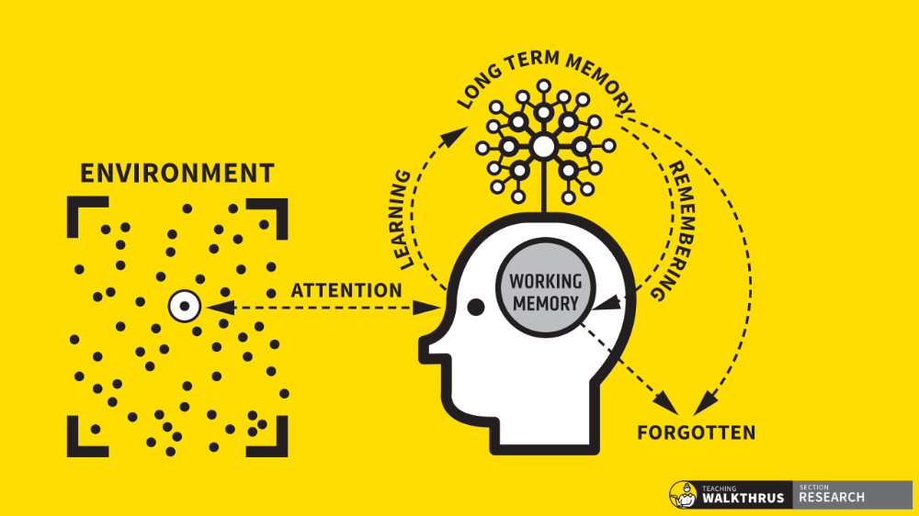
Checking for understanding.
Is this the strategy of strategies?Speaker
Tom Sherrington
@teacherhead
teacherhead.com

Slide 2
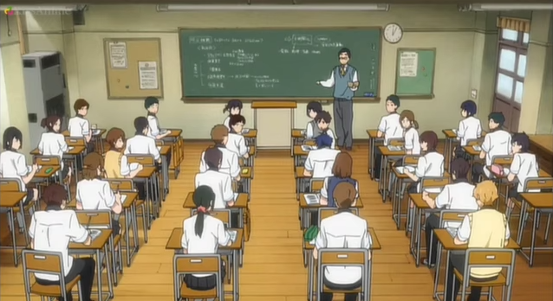
What’s going on?

Slide 3



Slide 4
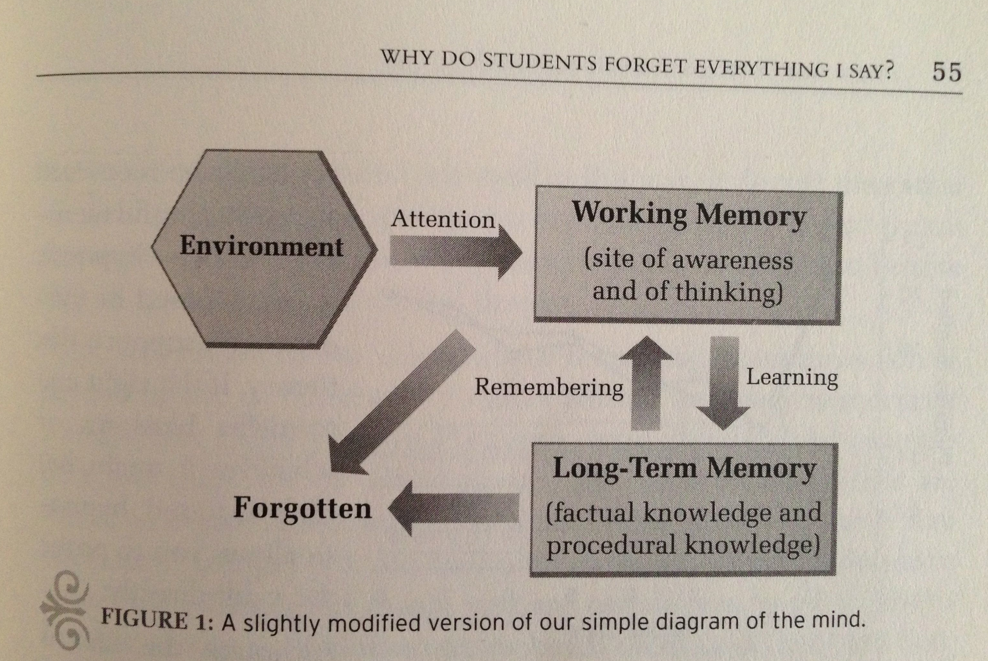
Daniel Willingham:

Slide 5
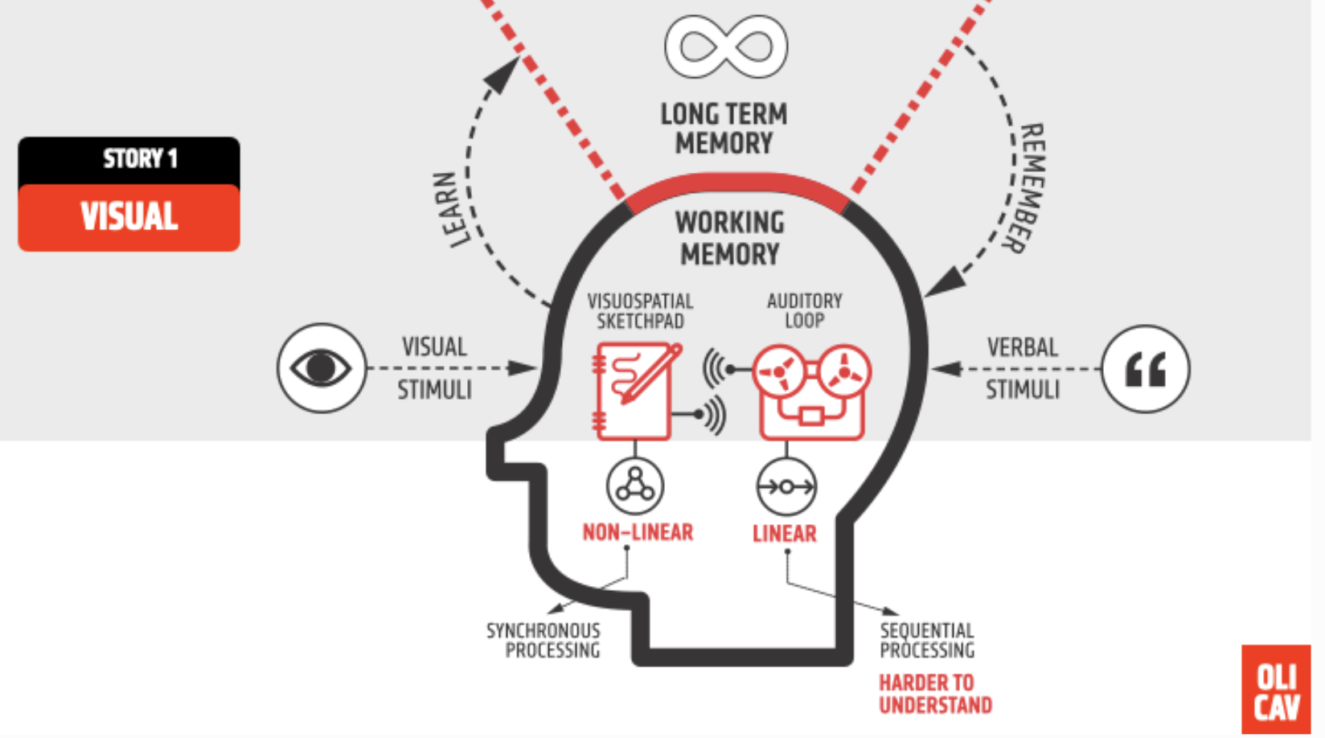
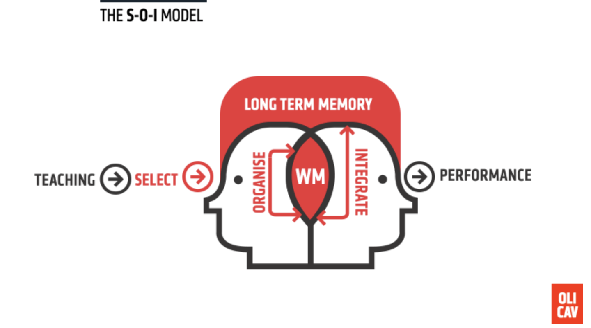

Slide 6
Daniel Willingham:
Understanding: remembering in disguise; capacity to explain.
Memory is the residue of thought
Drills for fluency
Power of stories

Slide 7
Why does your heart beat faster during exercise?

Slide 8
Lack of prior knowledge
Insufficient fluency of recall
Attention deficits
Task completion poor proxy for learning:
Memory overload:

Slide 10
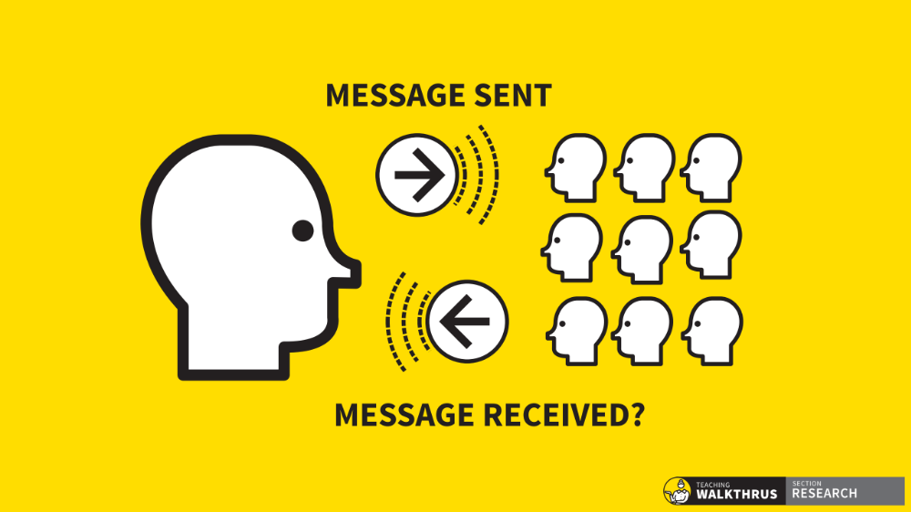

Slide 11

“The teacher, by lowering the level of questions and by accepting answers from a few, can keep the lesson going but is out of touch with the understanding of most of the class..”

Slide 12
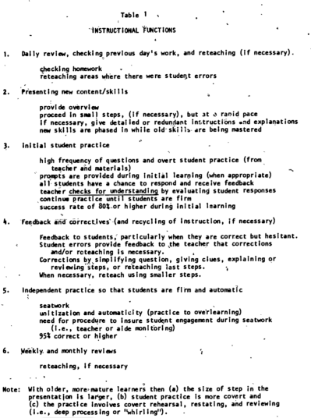
Rosenshine’s Instructional Functions: Draft. 1982
“checks for understanding”

Slide 13


Check for understanding
Have you understood?
What have you understood?

Slide 14
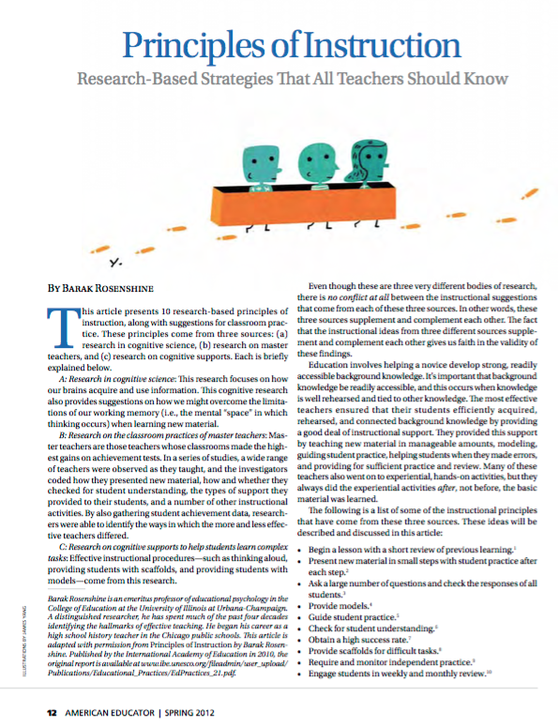
More effective teachers frequently checked to see if all students were learning the new material.
This has two purposes:
answering the questions might cause students to elaborate on material they have learned and augment connections to other learning in their LTM
alerting the teacher to when part of material need to be retaught.

Slide 15
By contrast, less effective teachers simply asked
”Are there any questions”.
If there were no questions, they assumed the students had learned the material and proceeded to pass out worksheets for students to complete on their own.

Slide 16
Effective teachers stopped to check for understanding by:
Asking questions
Asking students to summarise the presentation up to that point.
To repeat directions or procedures
Asking students whether they agreed or disagreed with other students’ answers.
Asking students to think aloud as they work through problems or plan an essay.
Asking students to explain or defend their position to others.

Slide 17
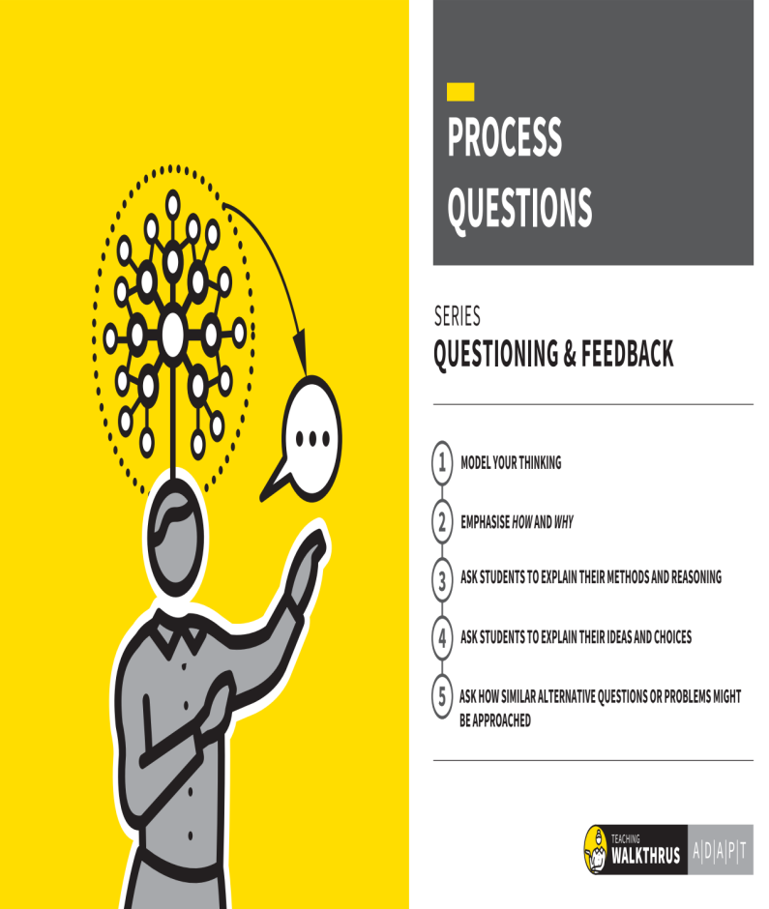
Checking for understanding during class instruction

Slide 18
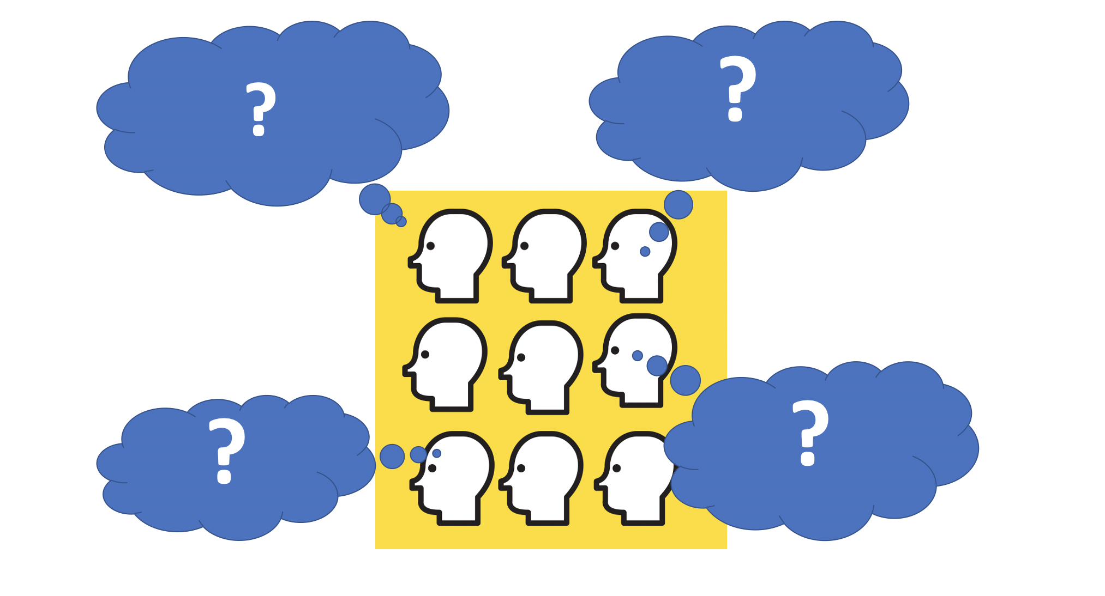
Is everyone thinking?

Slide 19


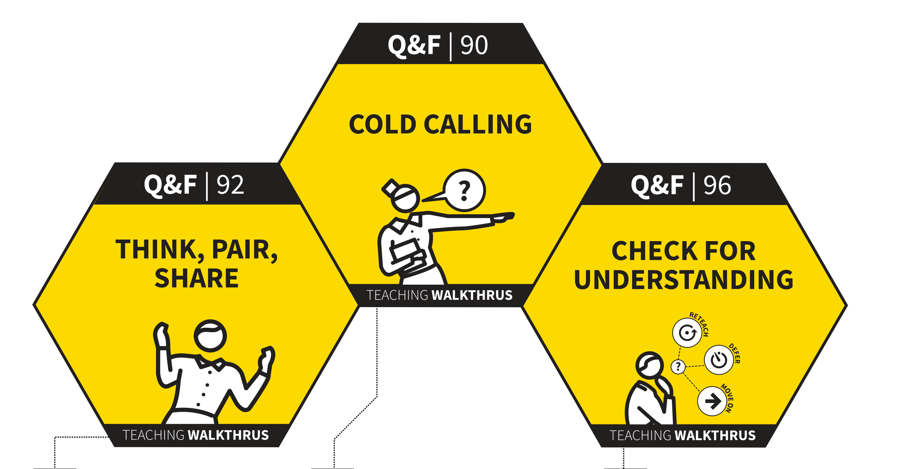

Slide 20
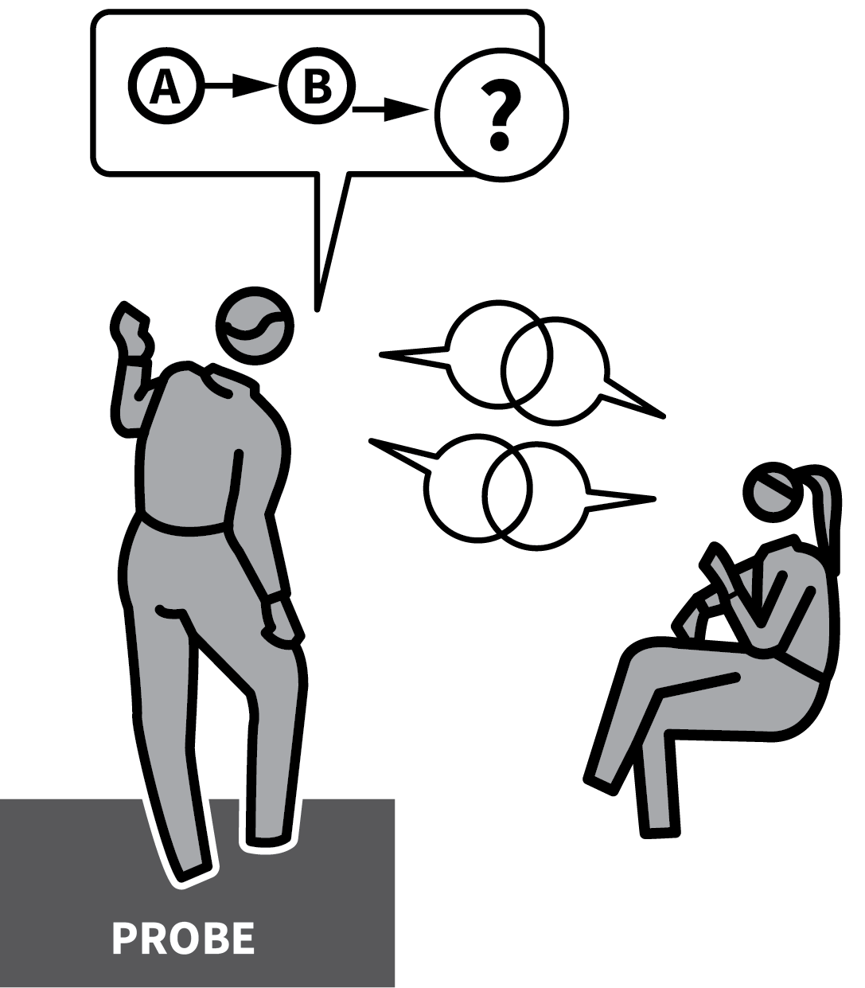
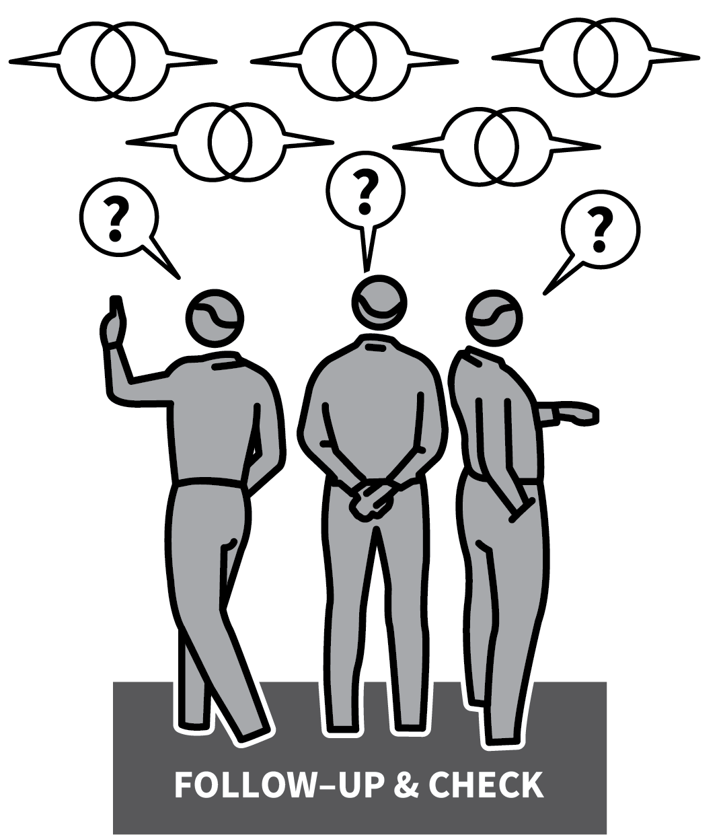

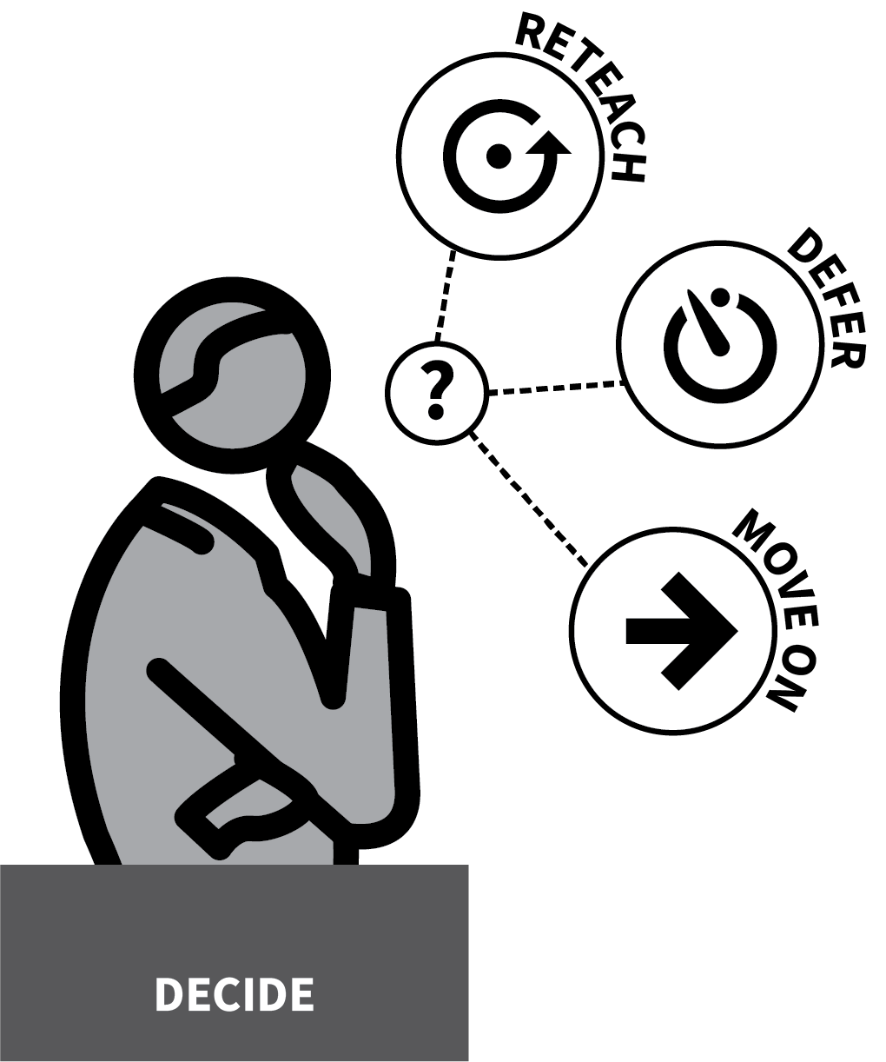
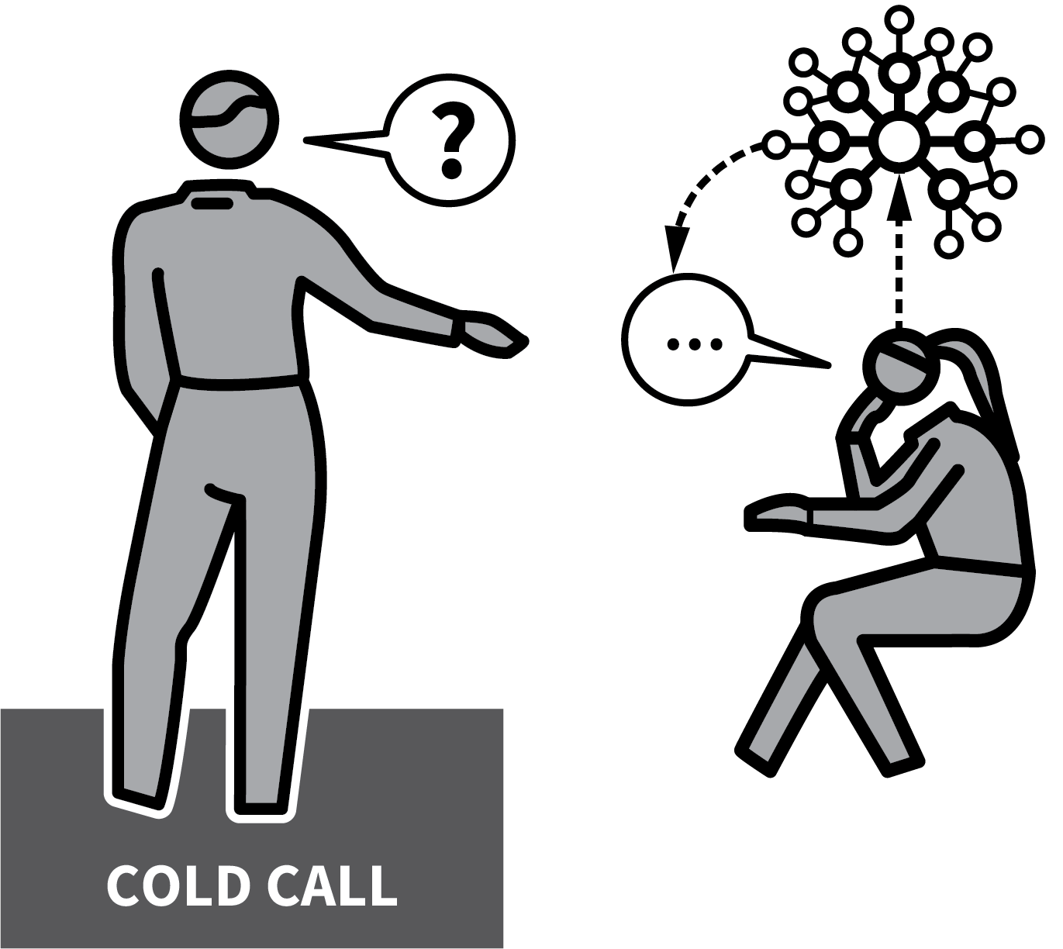

CHECK FOR UNDERSTANDING
1
2
3
4
5
COLD CALL, ASKING WHAT, NOT IF
PROBE WITH A SHORT DIALOGUE
FOLLOW-UP WITH MORE CHECKING DIALOGUES
EXPLORE DIFFERENCES AND DETAILS
RE-TEACH, DEFER OR
MOVE ON

Slide 21
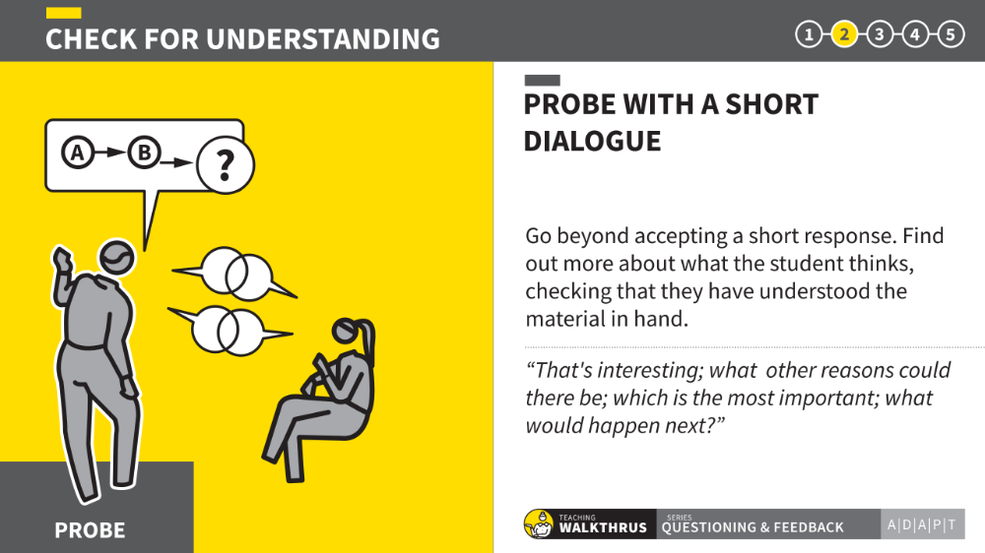

Slide 22
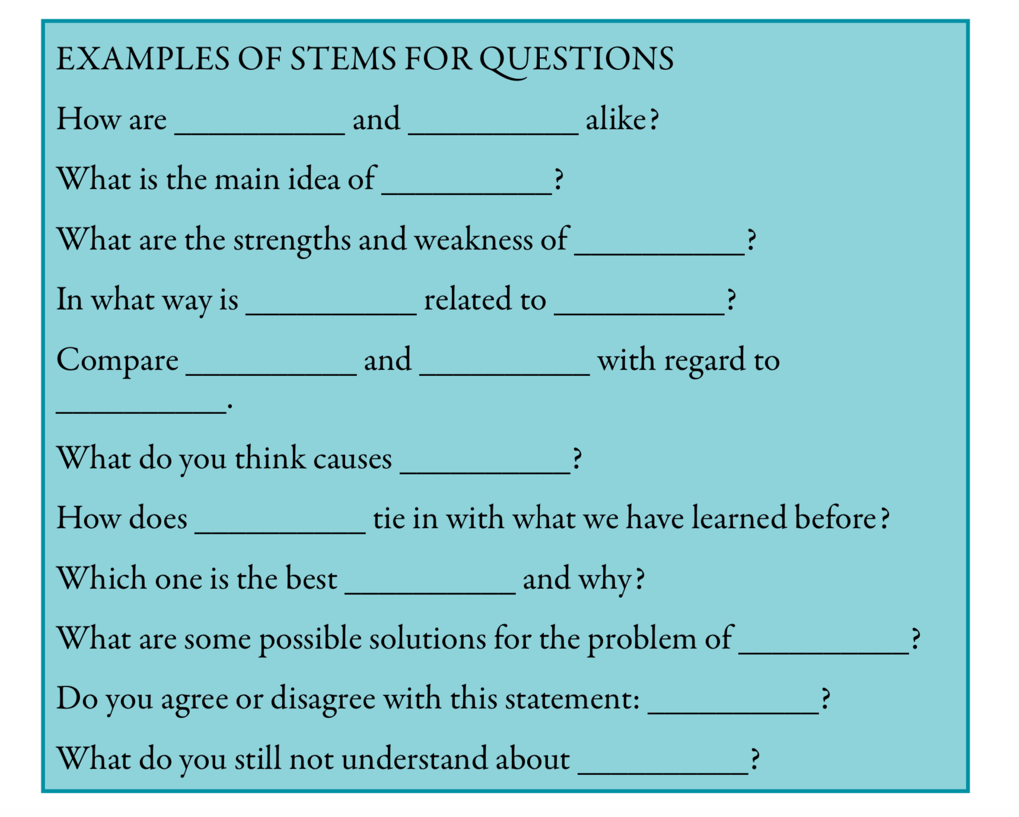

Slide 23
Scaffolds for dialogue
Full sentences. An example of a non-metal is…
At first….. Then
In my opinion…
Firstly…. Secondly…. And finally..
On one hand…. On the other hand.
An advantage of …. whereas a disadvantage..
X happens because...
If X happens… this in turn causes…

Slide 24
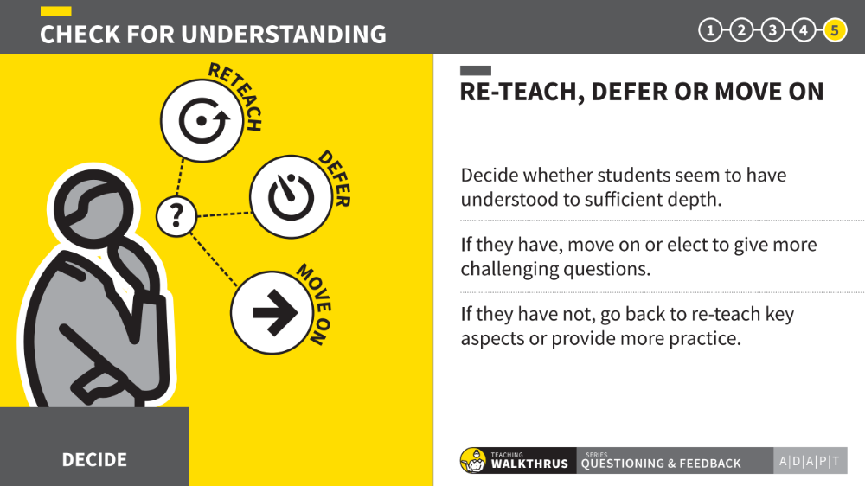

Slide 25
Why does the sun rise in the East?

Slide 26
Success Criteria:
Features | Success?
Before sunrise, Sun is at a distance, not visible to the part of the Earth experiencing night.
Earth rotates anticlockwise (looking from North pole) – ie towards the East.
As night moves to day, Sun appears on East horizon - to our left if we stand facing South.
The impression of ‘rising’ is an illusion; the Earth continues rotating relative to the Earth-Sun line, so the sun appears higher in the sky.

Slide 27
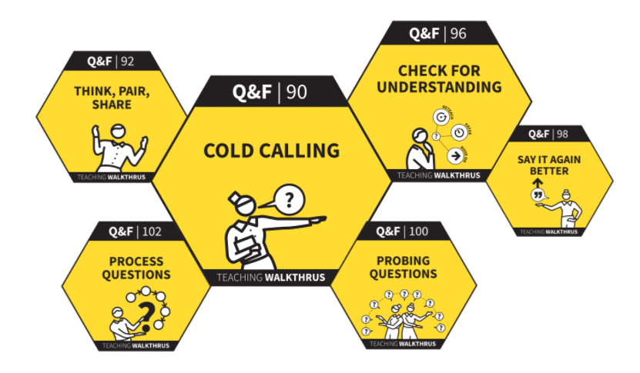

Slide 28
More examples… CfU is embedded in numerous strategies.

Slide 29
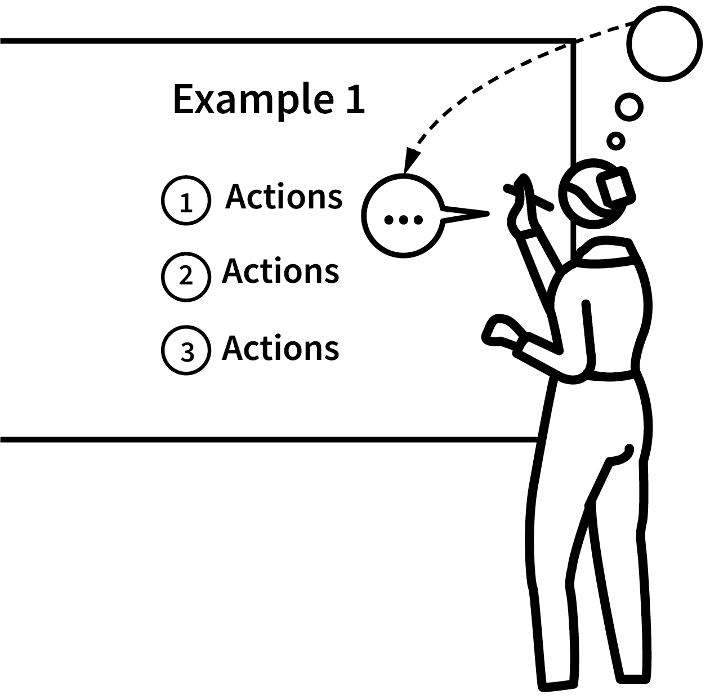
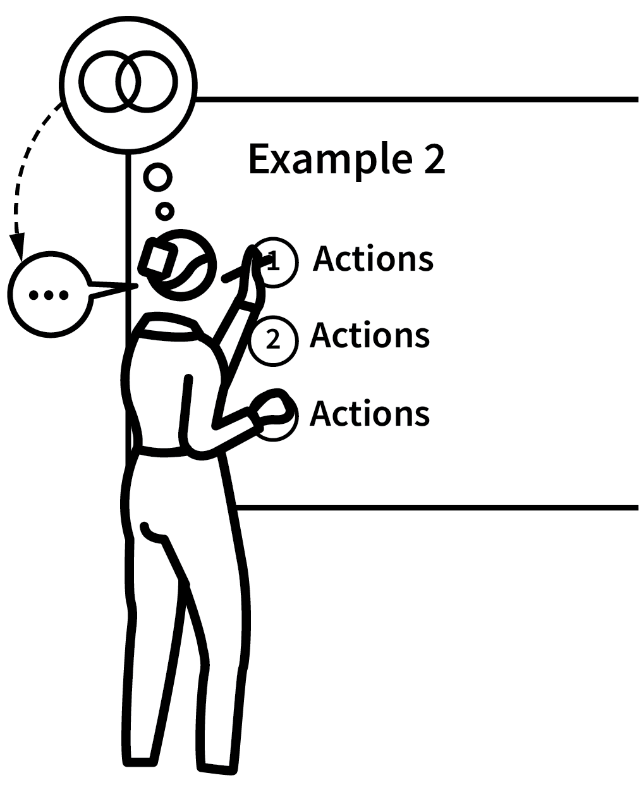
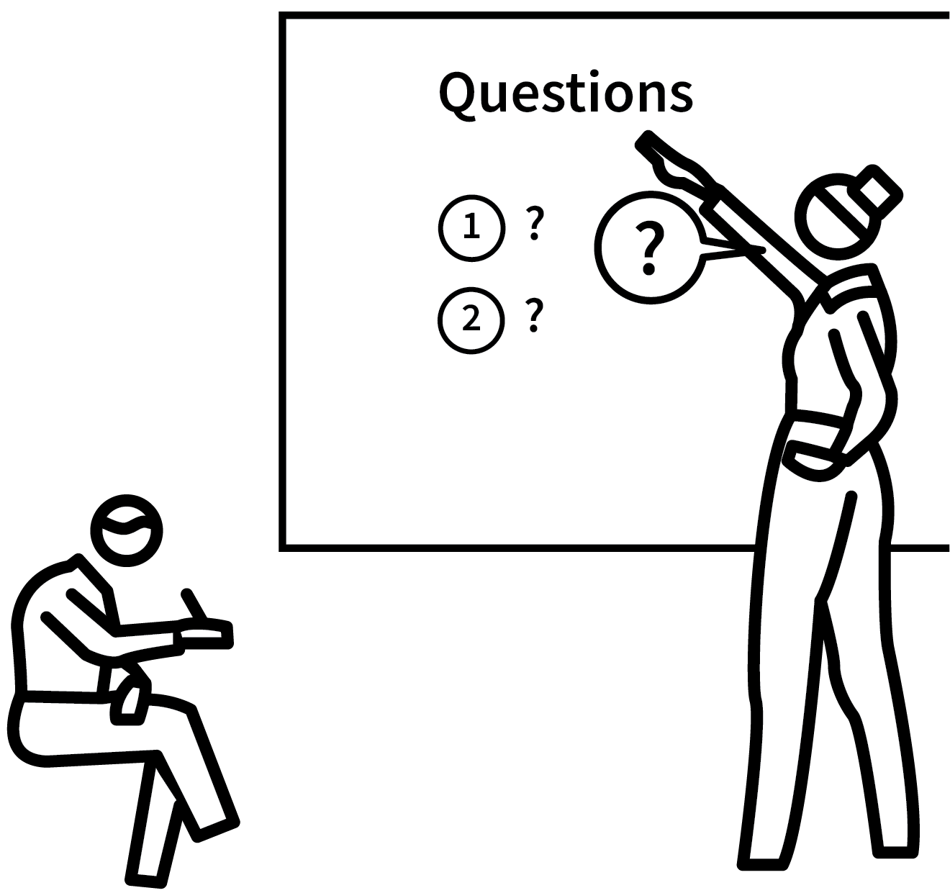
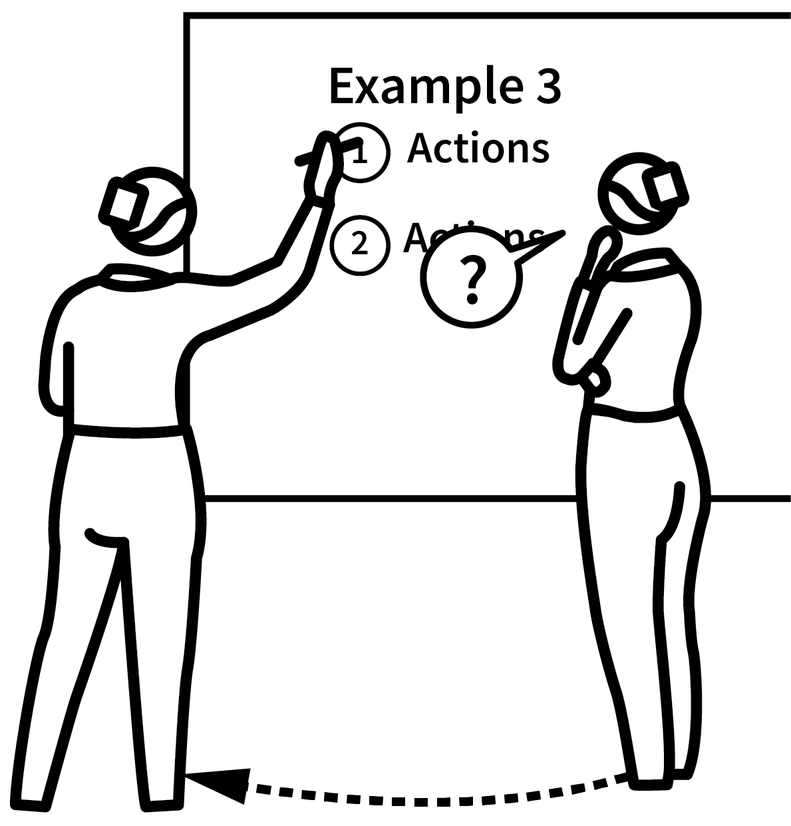
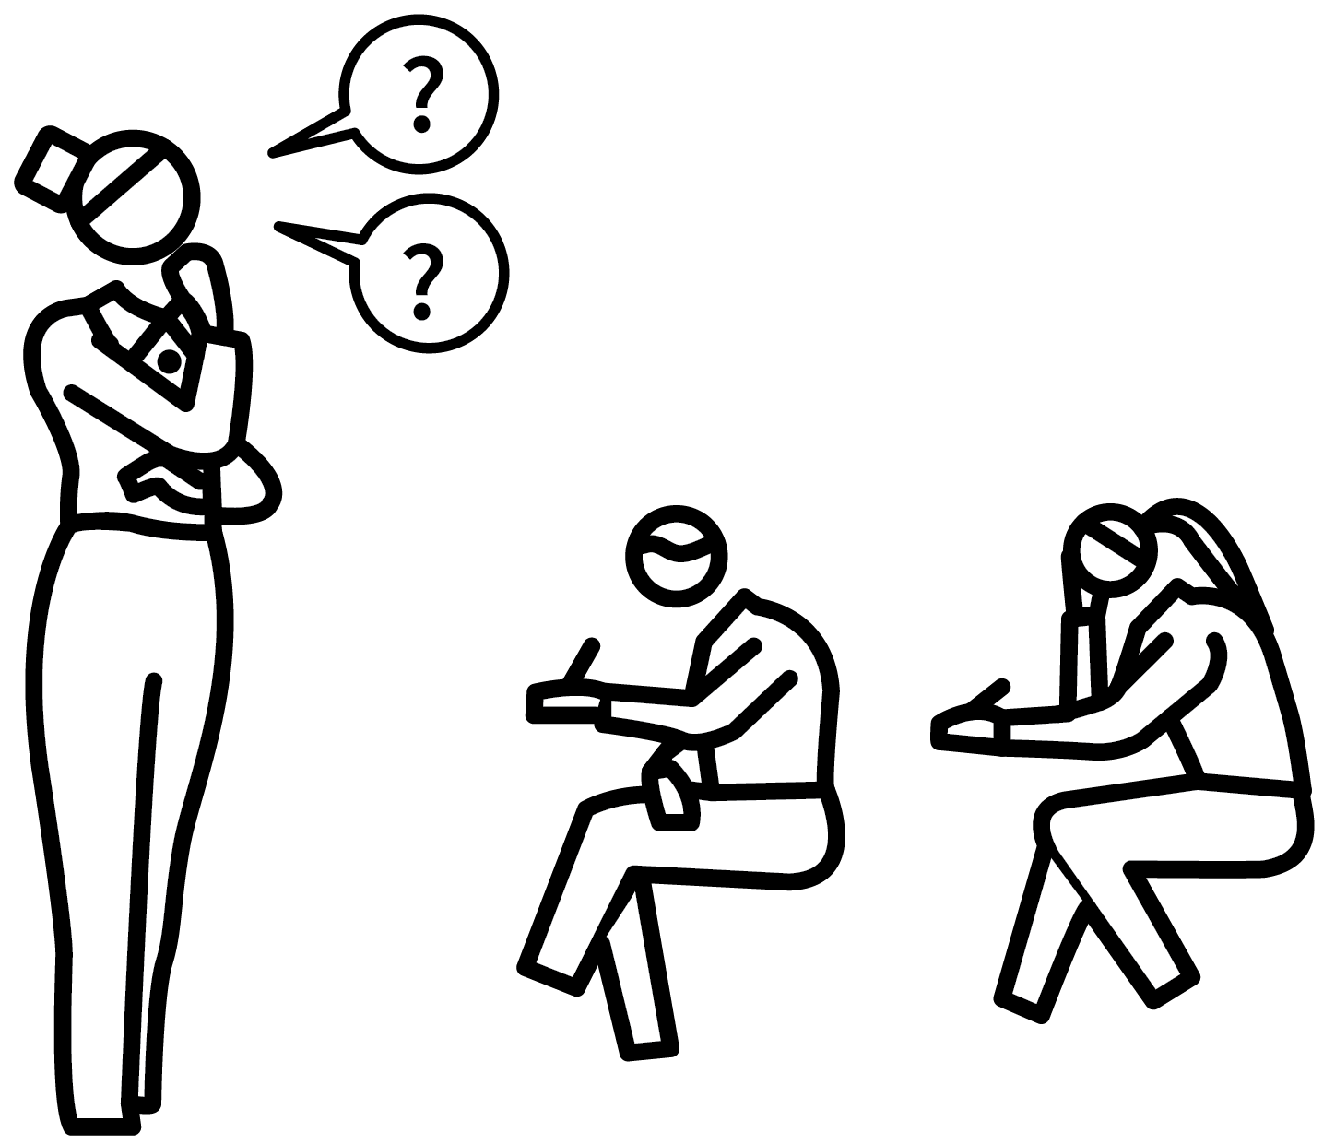
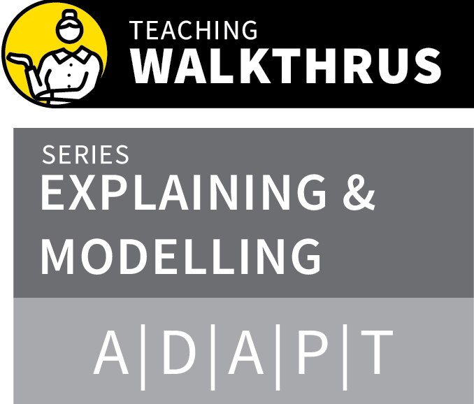
WORKED EXAMPLES & BACKWARD FADING
1
2
3
4
5
FULLY WORKED TO INTRODUCE THE METHOD OR IDEAS
FULLY WORKED FOR REINFORCEMENT
PARTIALLY WORKED FOR STUDENTS TO FINISH OFF
CUED START FOR STUDENT COMPLETION
COMPLETED INDEPENDENTLY
Cognitive Load Theory suggests novices learn more successfully studying complete worked examples than if asked to problem-solve independently.
Cognitive load is reduced if we learn the overall method separately from trying to apply it.
Often teachers do not model sufficient worked examples.
Backward fading is good for moving from guided to independent practice.

Slide 30
Worked Examples
18% of $65
18 x 65
100
= 0.18 x 65
= $11.70
37% of $120
37 x 120
100
= 0.37 x 120
= $44.40
68% of $1050
68 x 1050
100
= 0.68 x 1050
= $714.00

Slide 31
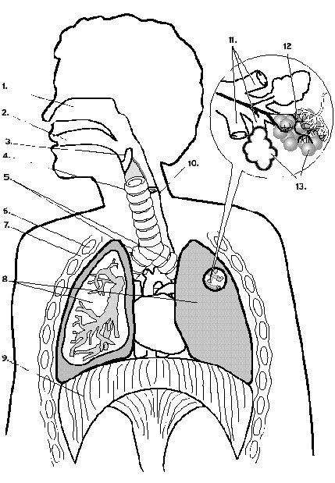
Trachea
Alveolus
Bronchiole
Diaphragm

Slide 32
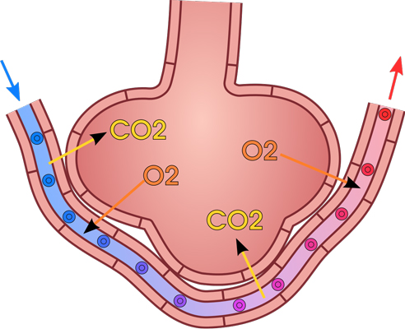

Slide 33
Key concepts
Capillary – small, bring blood close to surface
Oxygen from air – needed for respiration
Carbon dioxide – waste product of respiration
Diffusion (high conc to low conc)
Large surface area; gas exchange
Deoxygenated; oxygenated

Slide 34
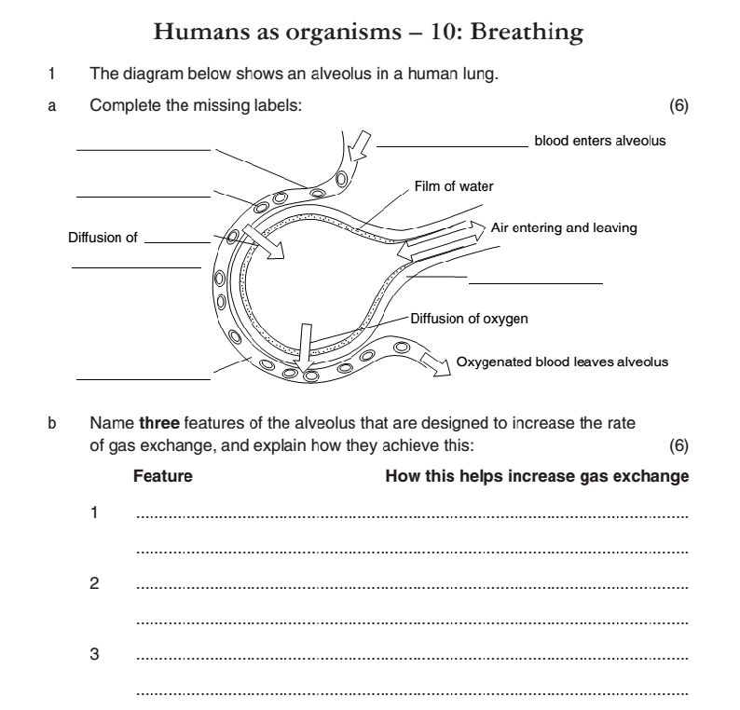
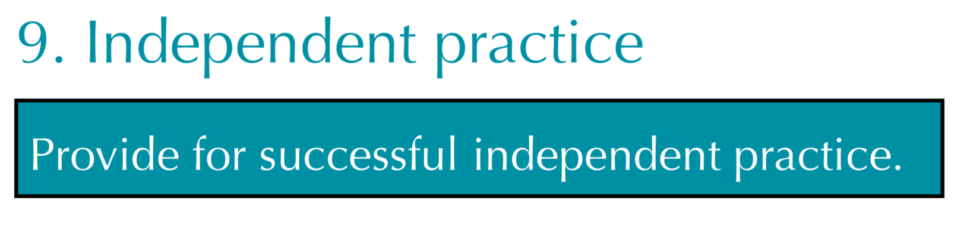

Slide 35

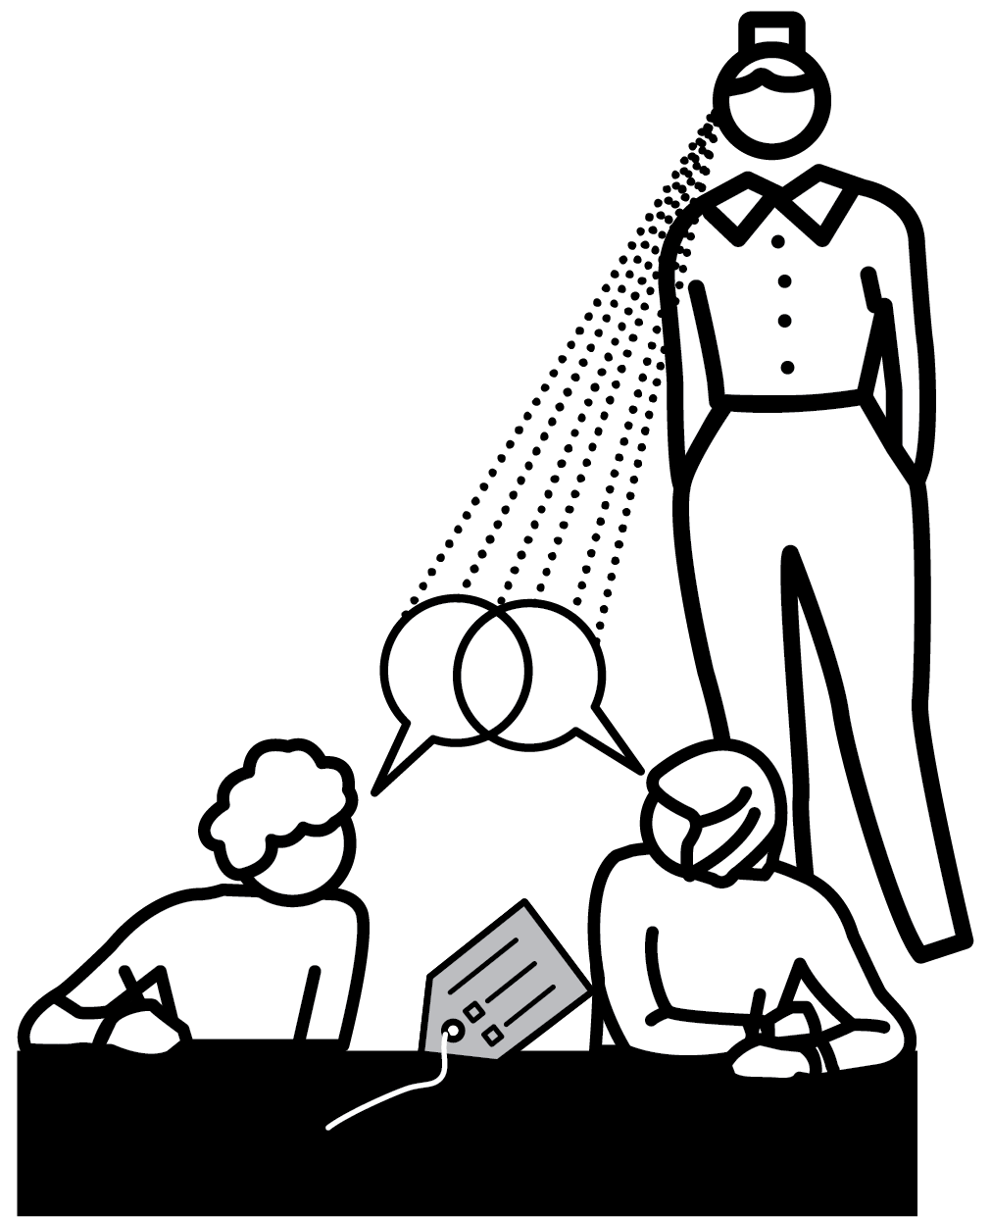

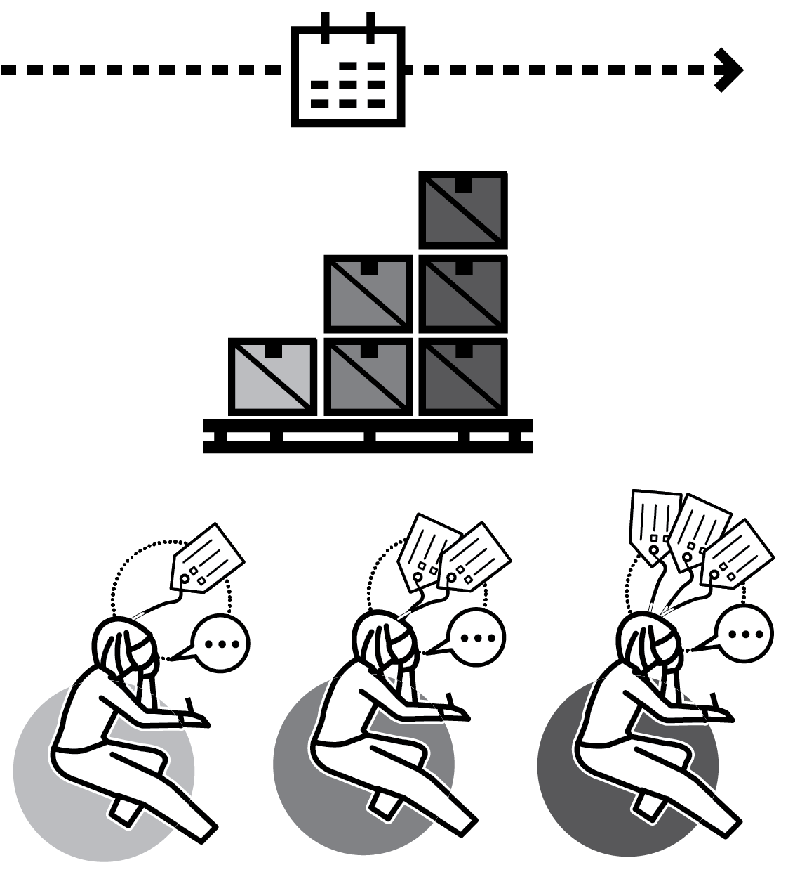
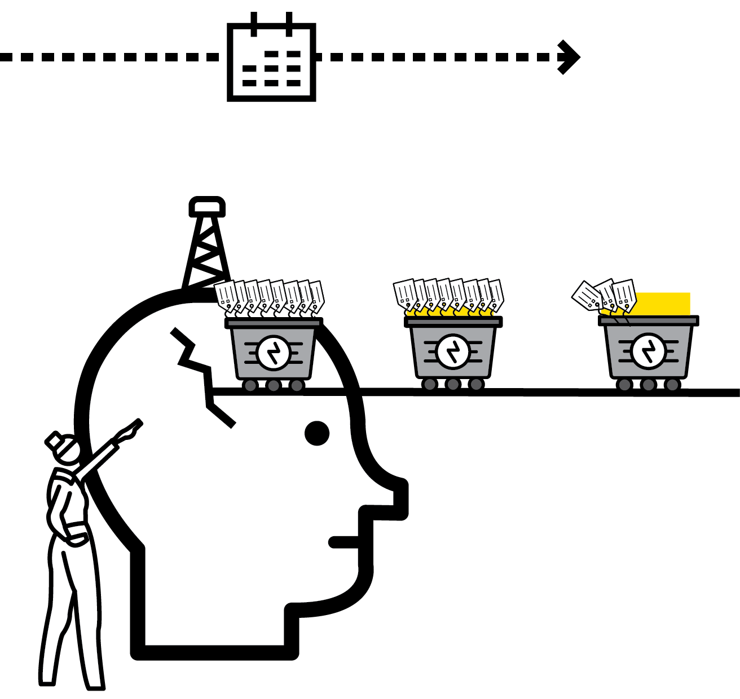
DELIBERATE VOCABULARY DEVELOPMENT
1
2
3
4
5
SPECIFY AND DEFINE THE WORDS
SAY THE WORDS
READ WORDS IN CONTEXT
PRACTISE USING THE WORDS VERBALLY AND IN WRITING
ENGAGE IN WORD-BASED RETRIEVAL PRACTICE

Slide 36
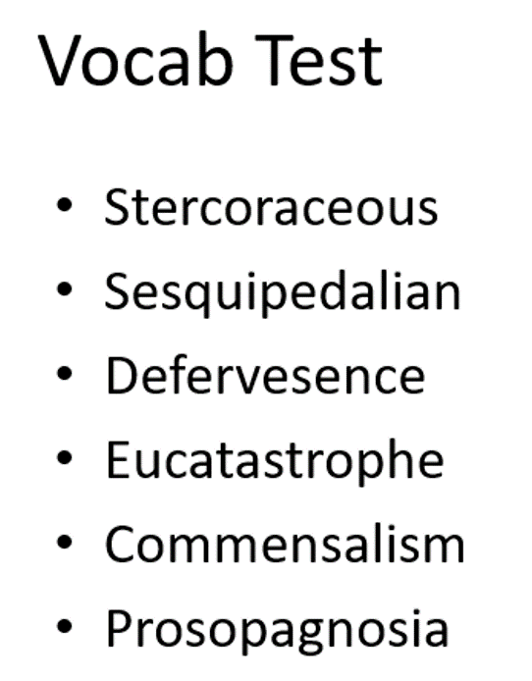
Build the words

Slide 37
Words in context
In a panic about his prosopagnosia, Tom scanned the room. He drew a blank as usual. Thank goodness; he could feel the defervesence after having eaten that stercoraceous porridge for breakfast.
He hoped for a degree of commensalism between himself and the audience - despite his habitual sesquipedalian delivery - and the usual eucatastrophe as he delivered the punchline. Laughter. Relief. It was over.

Slide 38
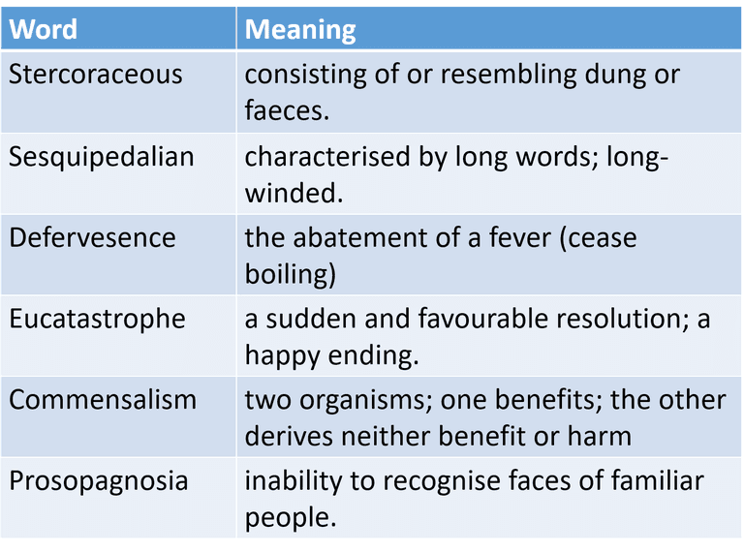

Slide 39
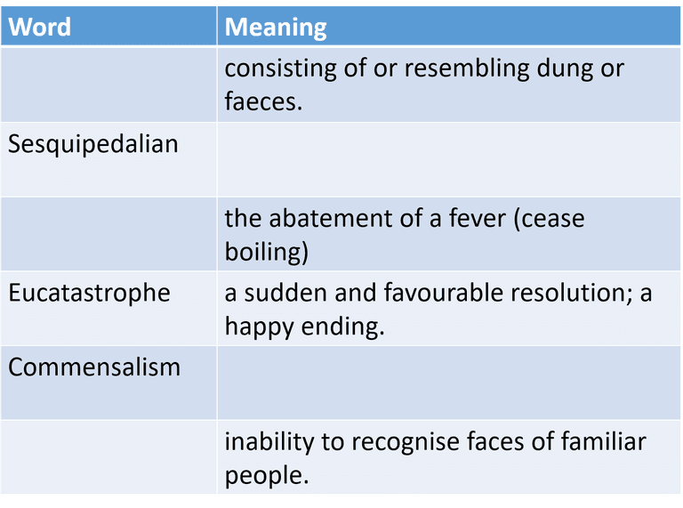

Slide 40
Which is correct?
Sesquipedalian people are in their 70s.
The man felt sesquipedalian after his operation.
John was a rather sesquipedalian speaker; his audiences would sometime lose focus.
The speech was full of sesquipelalian facts that didn’t support her main argument.

Slide 41
Lack of prior knowledge
Insufficient fluency of recall
Attention deficits
Task completion poor proxy for learning:
Memory overload:

Slide 43
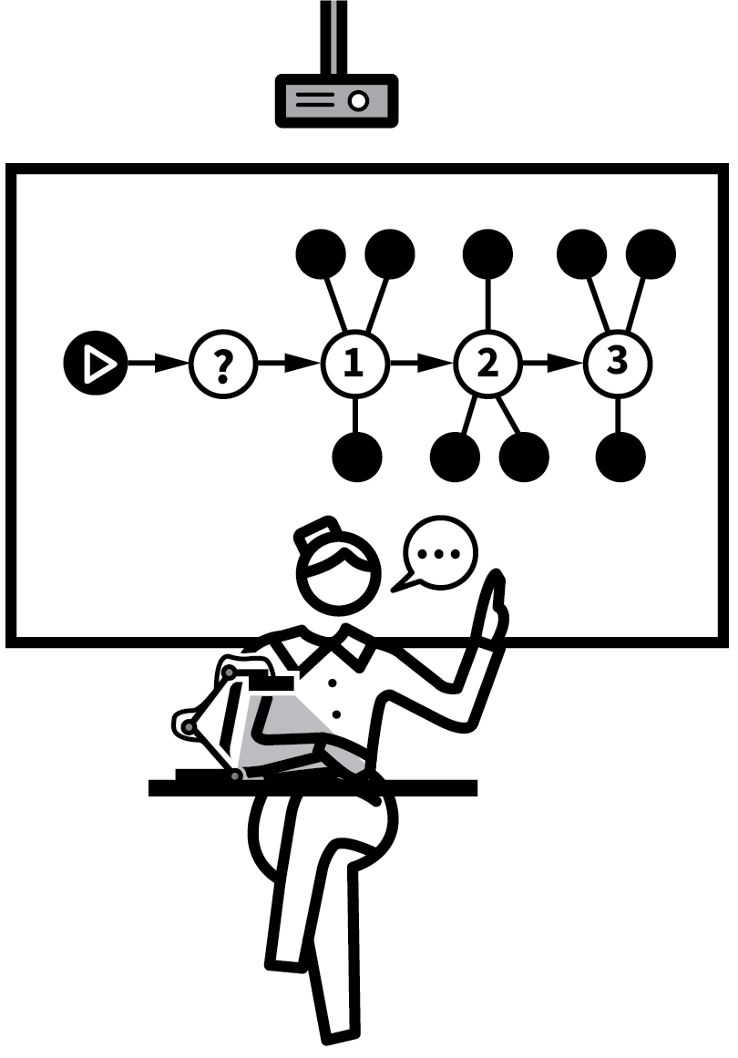
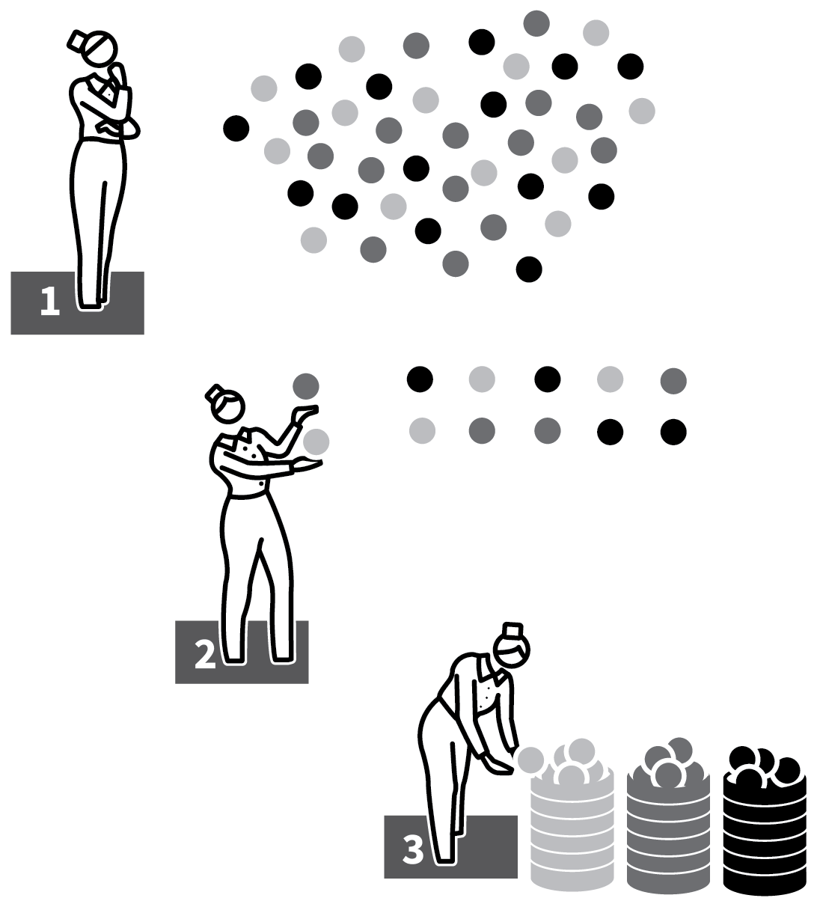
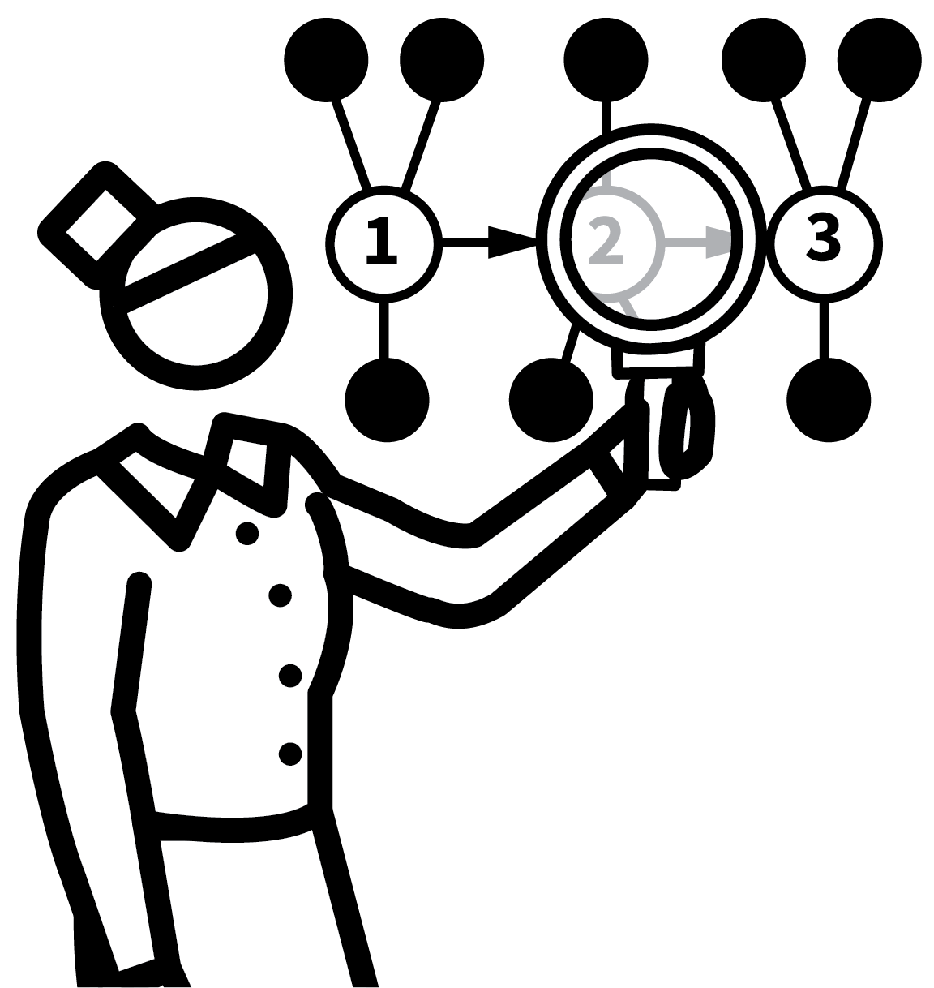
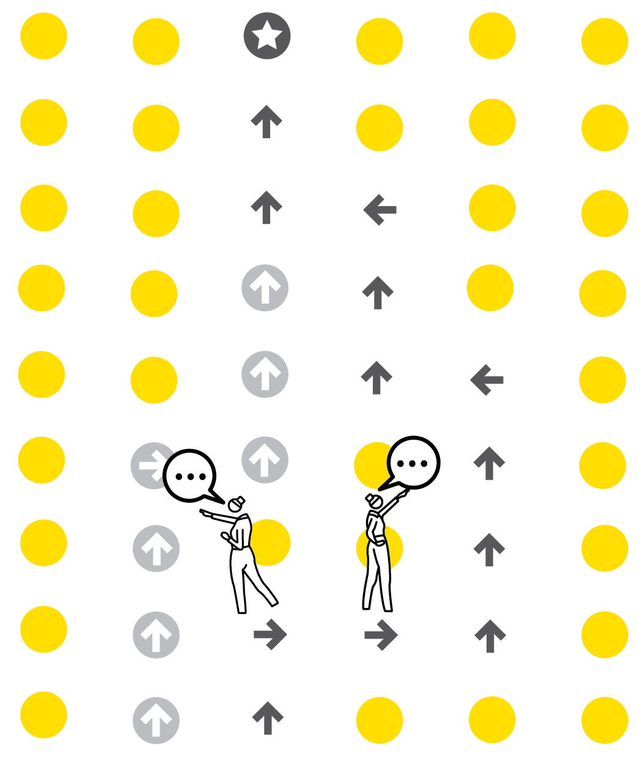
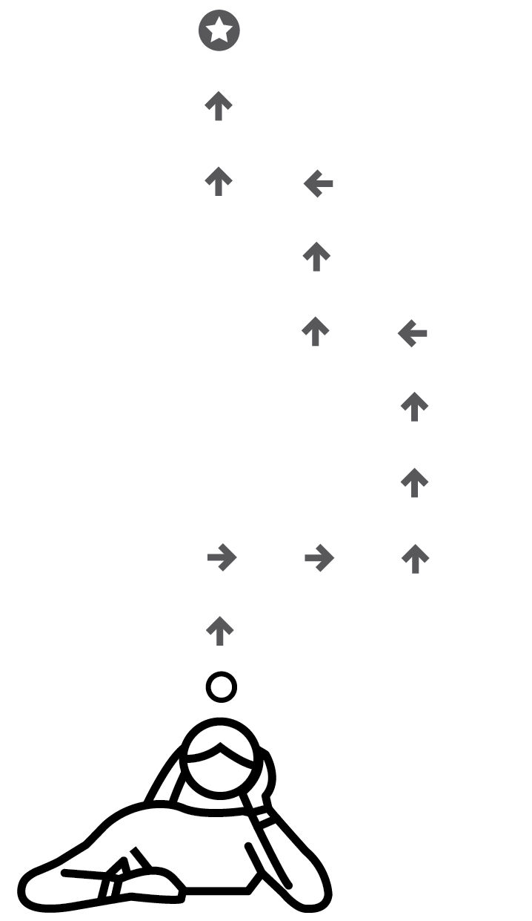
LIVE MODELLING
1
2
3
4
5
MODEL EACH STAGE STEP BY STEP
MODEL HOW YOU ORGANISE MESSY THINKING
REVIEW THE SUCCESS OR QUALITY OF YOUR
OWN WORK
MODEL ALTERNATIVES AND
FURTHER EXAMPLES
SET TASKS TO EMULATE THE MODEL
For effective instructional teaching, teachers need to walk through a learning process themselves, highlighting key procedures and the thinking that underpins them.
The metacognitive aspect is important, making implicit decision-making explicit.
Provide examples of completed work that can serve as scaffolds for students.

Slide 44
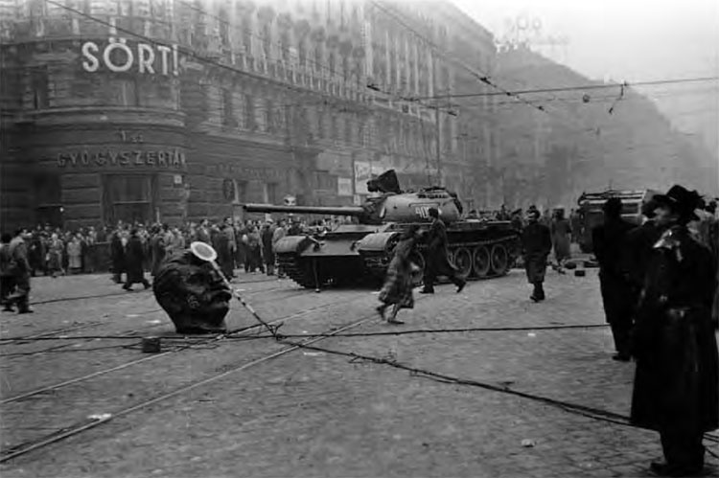
Write an account of how events in Hungary became an international crisis during 1956. [8 marks]

Slide 45
One reason how events in Hungary became an international crisis was that the West criticised the violent Soviet reaction. For example, when Nagy threatened to leave the Warsaw Pact, Khrushchev was afraid that this would weaken communist power. Khrushchev decided to send thousands of soldiers and tanks to Budapest, which resulted in over 10000 people being killed. This was an international crisis because it led to a war of words between the USA and USSR after the US objected and President Eisenhower openly criticised the Soviets.
Another reason why it was an international crisis was because it was the end of peaceful co-existence between the USSR and the West. For example, before the Hungarian Uprising, Khrushchev tried to ease relations between the USSR and the West, releasing political prisoners and criticising Stalin. However, after he was criticised in the UN by the USA and its allies, Khrushchev ended this policy. This was an international crisis because the thaw ended and relations in the Cold War were damaged after the West said that the USSR couldn’t be trusted, which led to more problems in the 1960s.

Slide 46
Extended Handover
TEACHER
I do it.
STUDENT
We do it together
You do it.

Slide 47
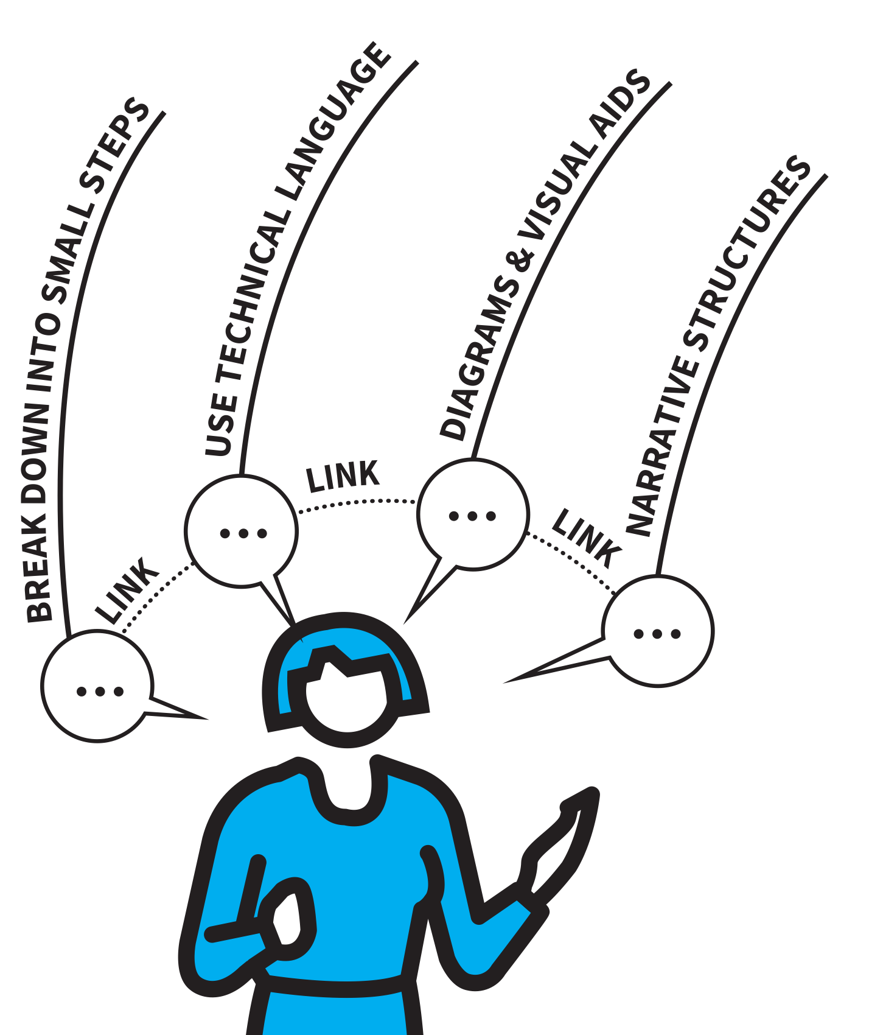
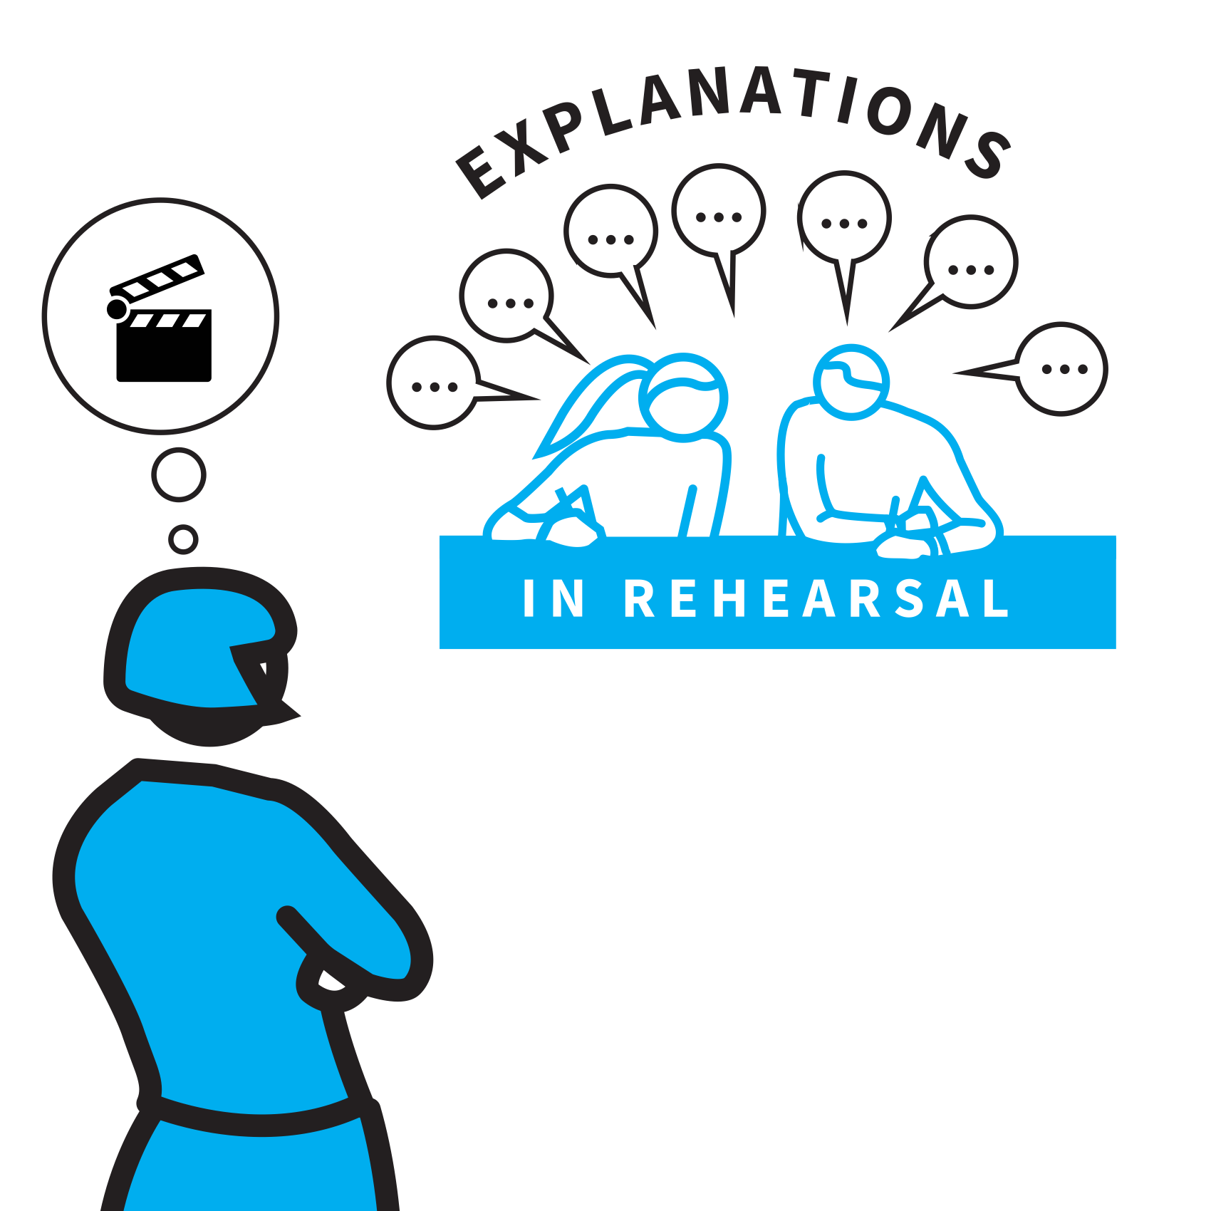

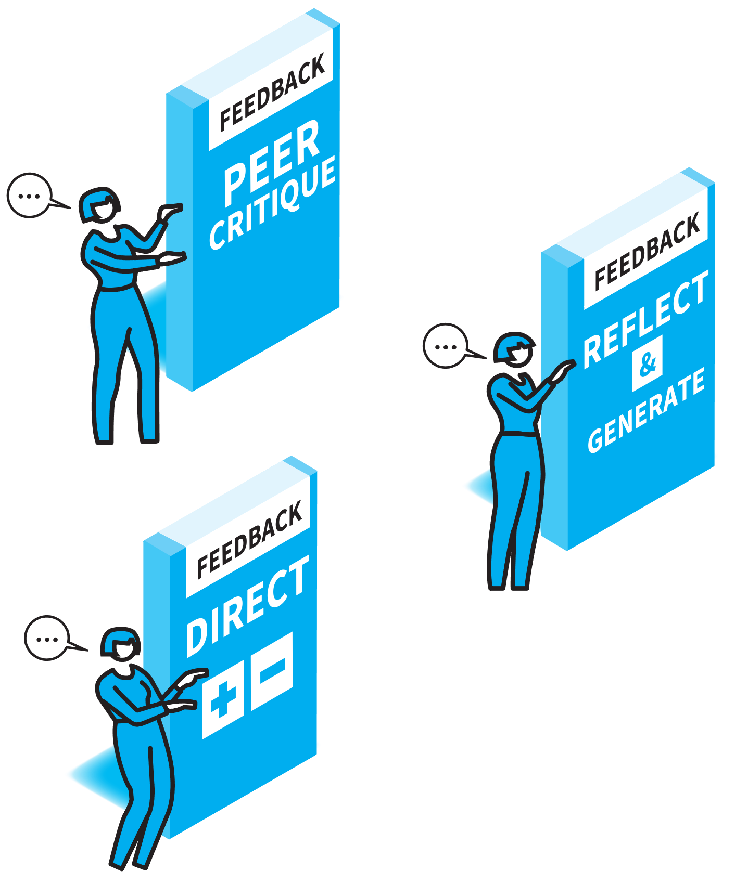
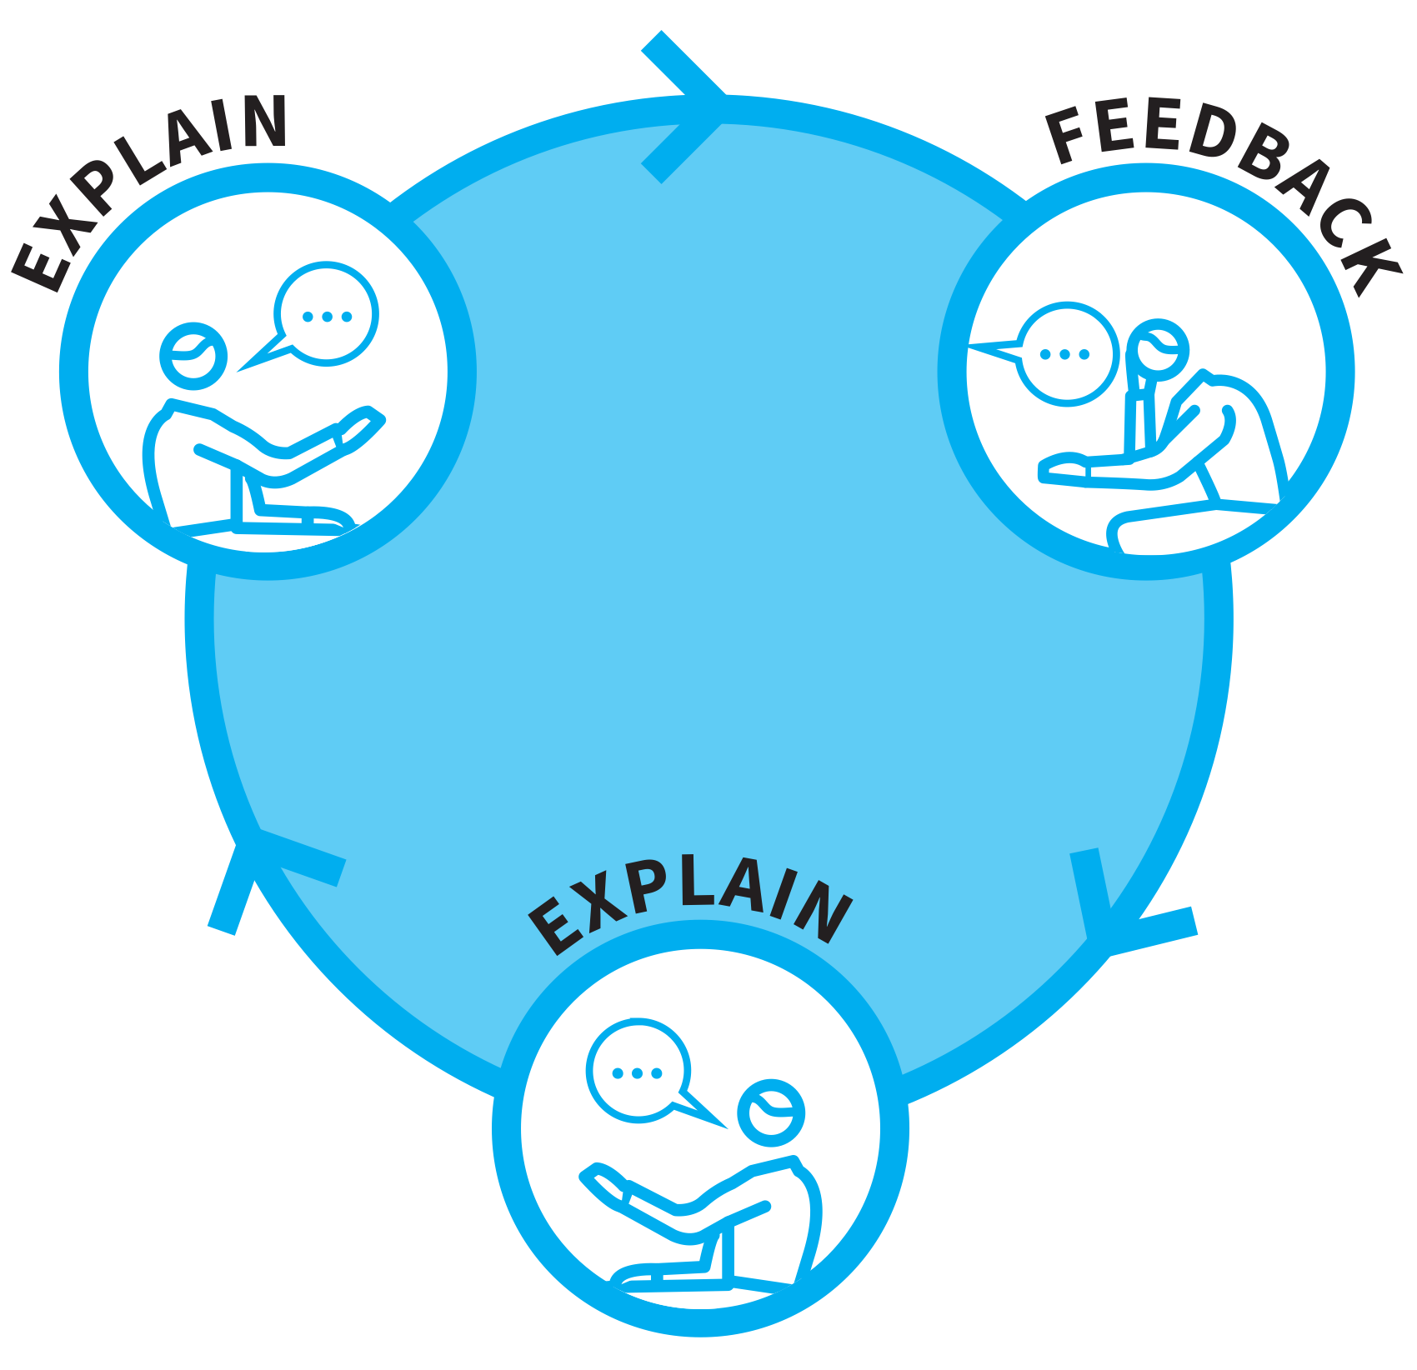

PRACTISE EXPLAINING
1
2
3
4
5
MODEL HIGH QUALITY EXPLANATIONS
ENGAGE ALL STUDENTS IN EXPLAINING REHEARSAL
SAMPLE WITH COLD CALLING
PROVIDE OR GENERATE FEEBACK
REPEAT FEEDBACK & IMPROVEMENT CYCLES
A powerful way for a student to develop their understanding of a concept, is to formulate and communicate a coherent extended explanation.
Doing this from memory requires them to have developed a secure schema for the key ideas and the capacity to sequence the ideas in a way that makes sense.
Students will need practice – the opportunity to repeat the process, with feedback cycles built in, to strengthen the depth and fluency of their explanations.

Slide 48
Why does it rain?
Key Words
Evaporation
Convection
Condensation
Precipitation
Energy
Warm/Cool
Flow
Vapour
Fall/rise

Slide 49
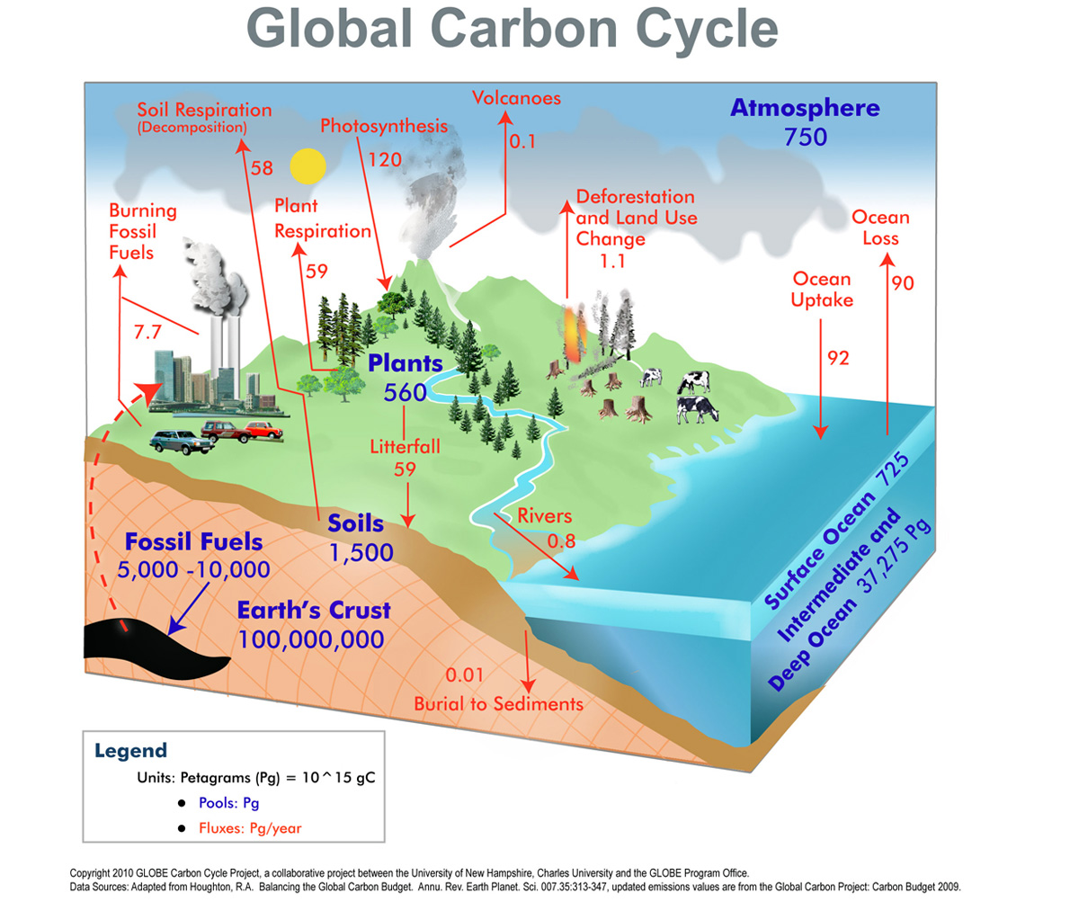
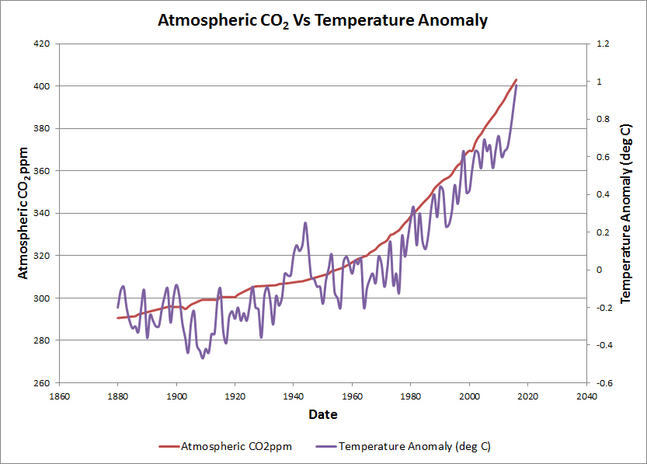
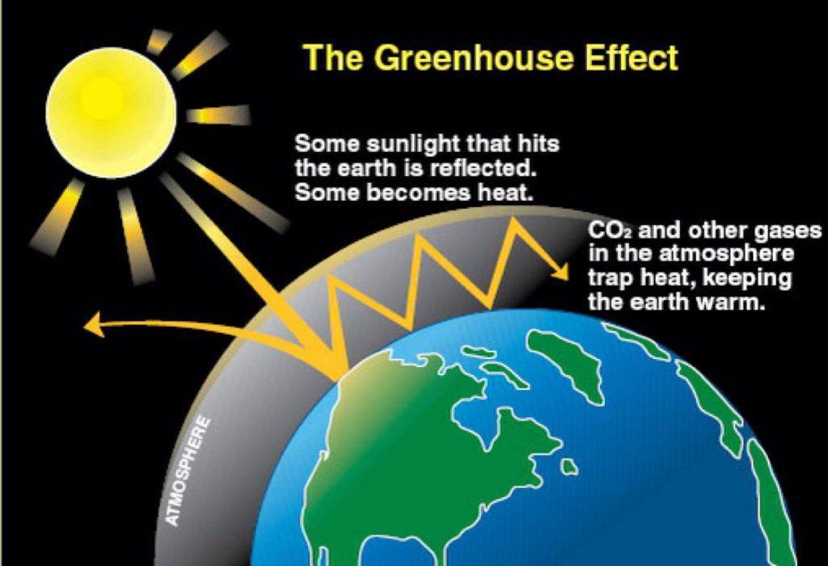
What’s the link between the greenhouse effect and global warming?

Slide 50
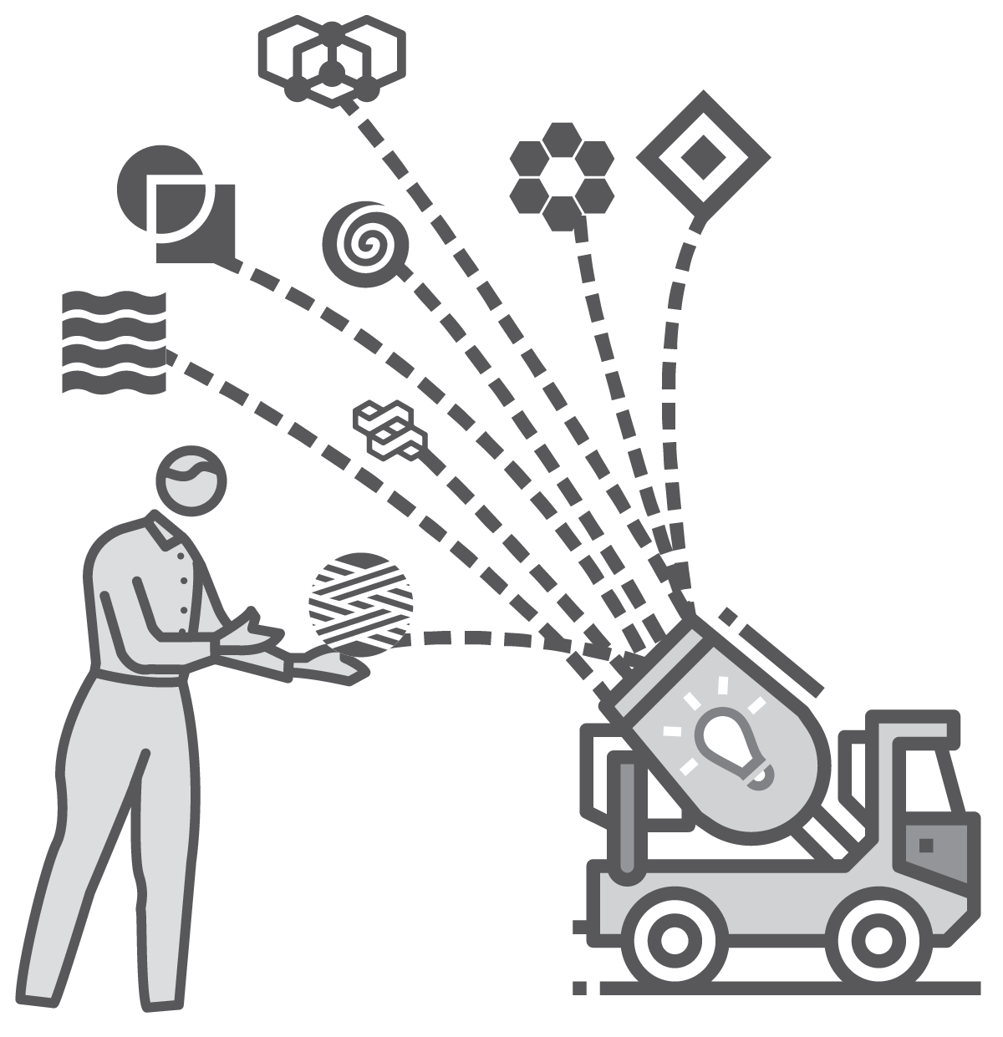
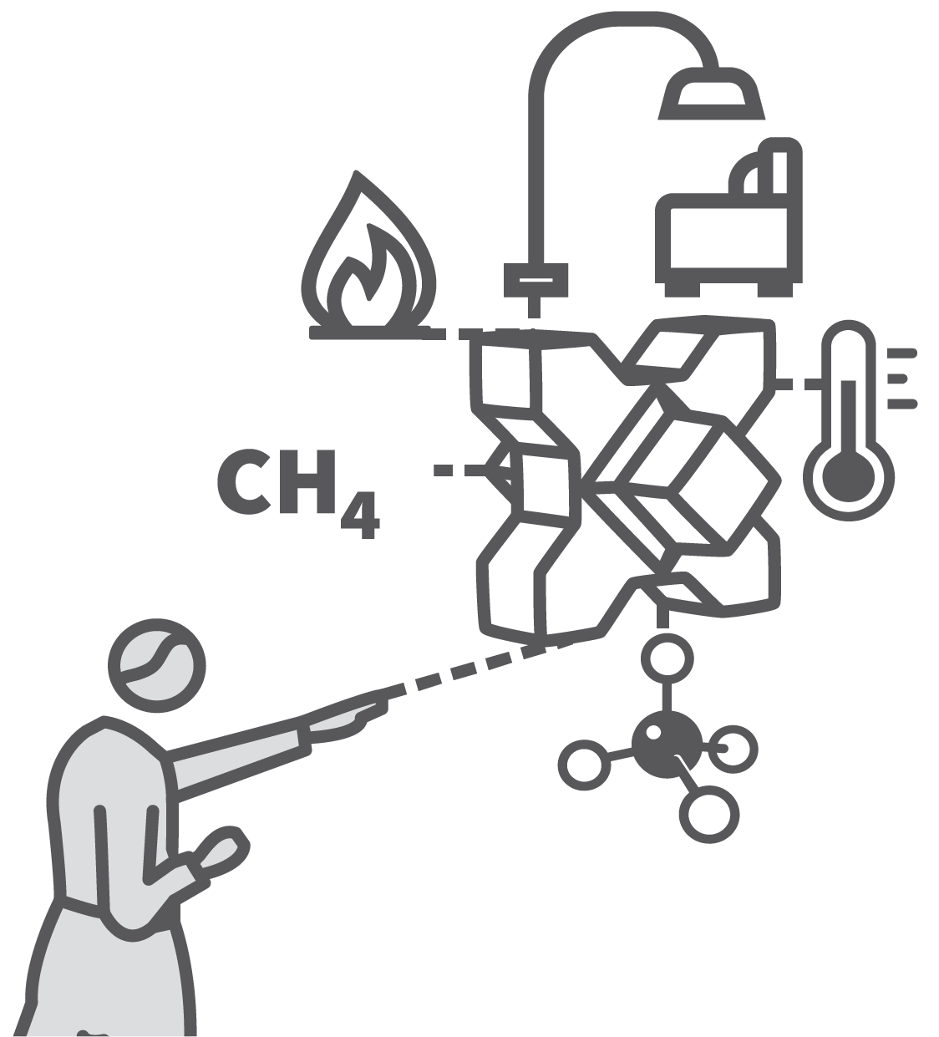




CONCRETE EXAMPLES
1
2
3
4
5
MAKE ABSTRACT–CONCRETE CONNECTIONS EXPLICIT
HIGHLIGHT A RANGE OF USEFUL CONCRETE EXAMPLES TO LEARN
QUIZ ON CONCRETE EXAMPLES FOR A GIVEN ABSTRACT IDEA
QUIZ ON ABSTRACT IDEAS FOR GIVEN CONCRETE EXAMPLES
EXTEND THE RANGE OF EXAMPLES
An important step in forming detailed schema is students’ capacity to link a set of specific concrete examples to some general rules or abstract ideas.
Students should illustrate abtract ideas with specific concrete examples.
If material is studied and can be recalled both ways round, students form more secure schema and become more fluent.

Slide 52


Slide 53


Slide 54

Craig Barton. SSDD

Slide 55
Modelling; scaffolding
Questioning;
Checking for understanding
Reviewing material
Stages of Practice
Material in small steps.

Slide 56
Checking for understanding.
Is this the strategy of strategies?Speaker
Tom Sherrington
@teacherhead
teacherhead.com

Slide 57





