Slide 1


Challenges of School Leadership
Tom Sherrington
@teacherhead
teacherhead.com
teacherhead.com

Slide 2
Great Leadership:
Ethos
Vision
Strategy
People
Communication
Delivery
Quality Assurance

Slide 3
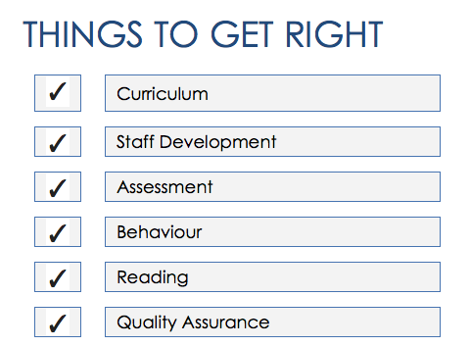
Leadership Challenges

Slide 4
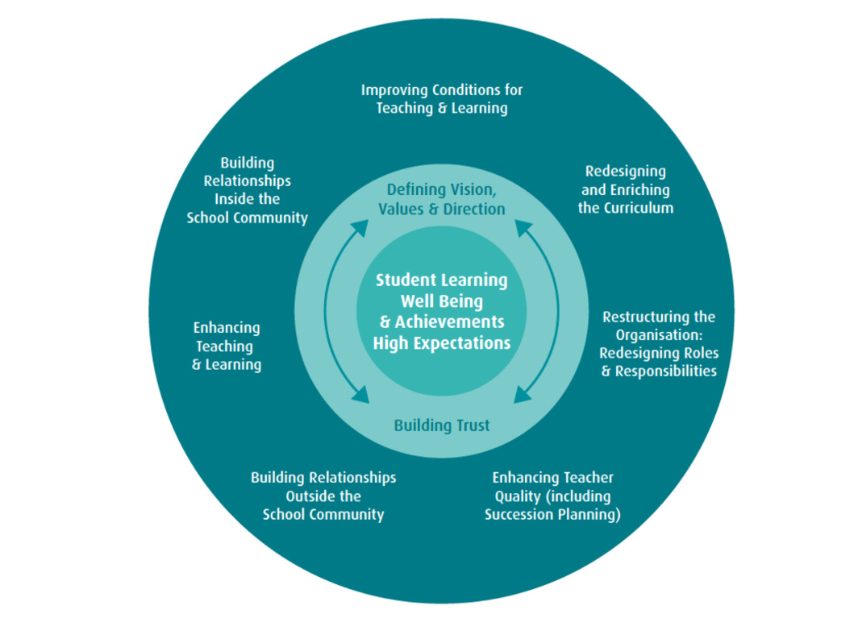

Slide 5
Balancing acts:
Tight:
Directing
Controlling
Scrutiny
Insisting on compliance
Loose:
Building consensus
Trust
Distributed leadership
Giving autonomy

Slide 7
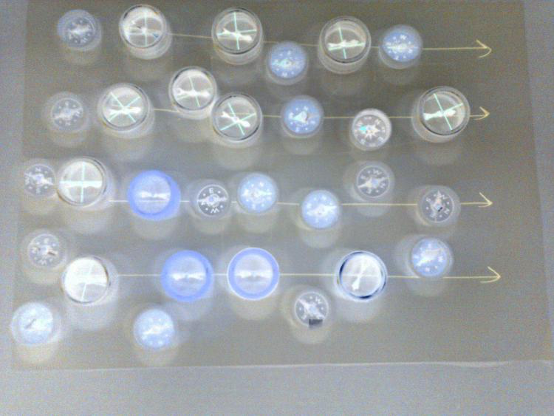

Slide 8
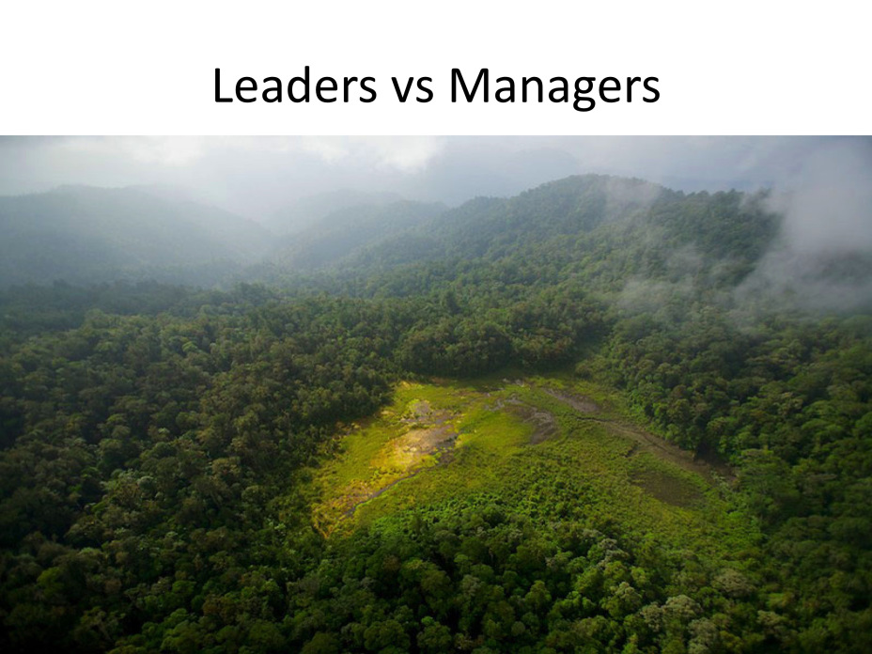

Slide 9
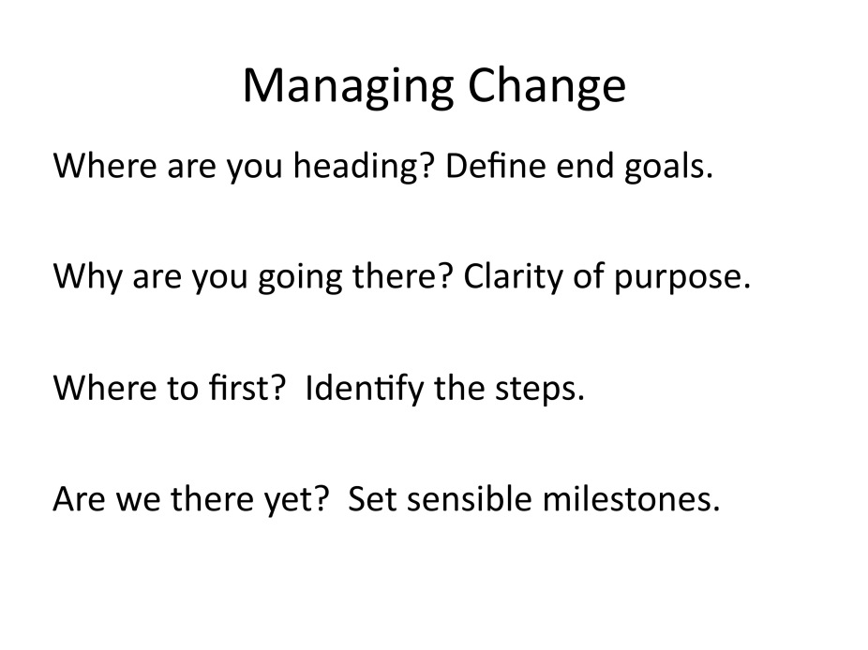

Slide 10
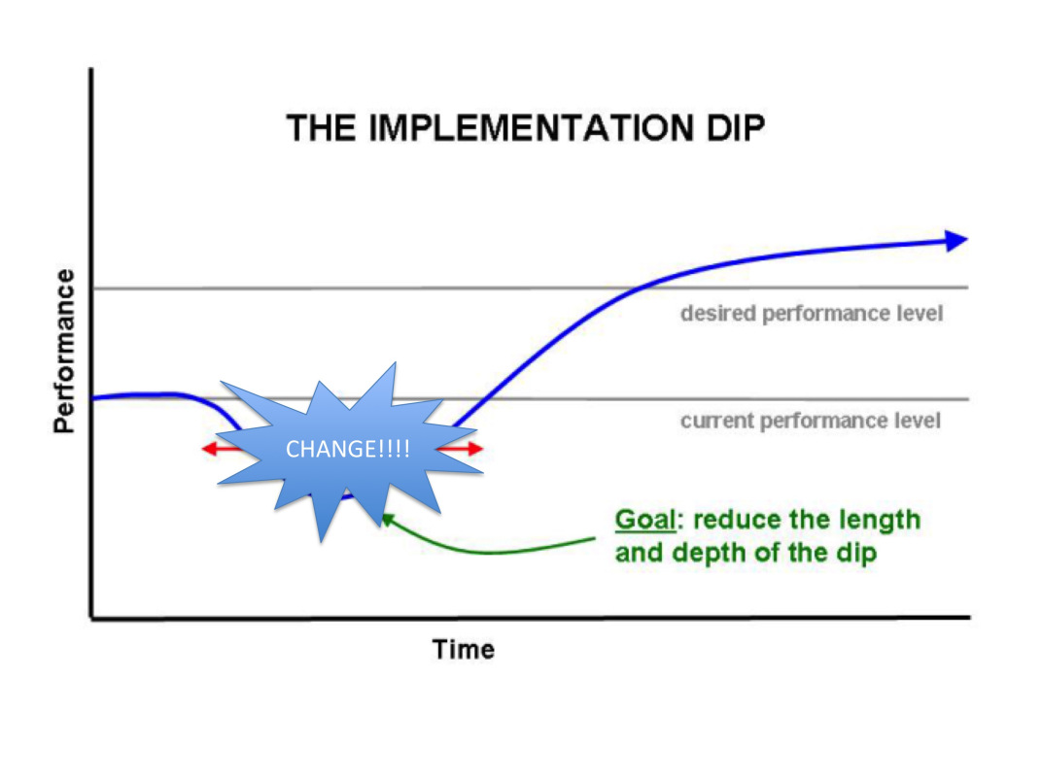

Slide 11

Relentless optimism. Yes, we can!

Slide 12


Slide 13
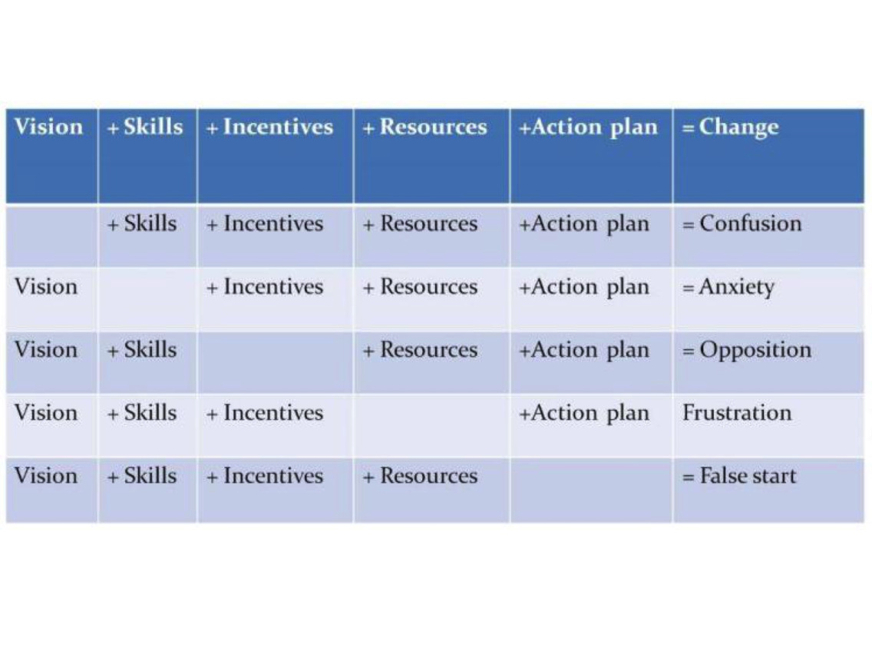

Slide 14

Thank You!
Tom Sherrington
@teacherhead
teacherhead.com
teacherhead.com

