Slide 1
Teaching and Learning at KEGS
November 6th Leading Edge Day
Tom Sherrington

Slide 2
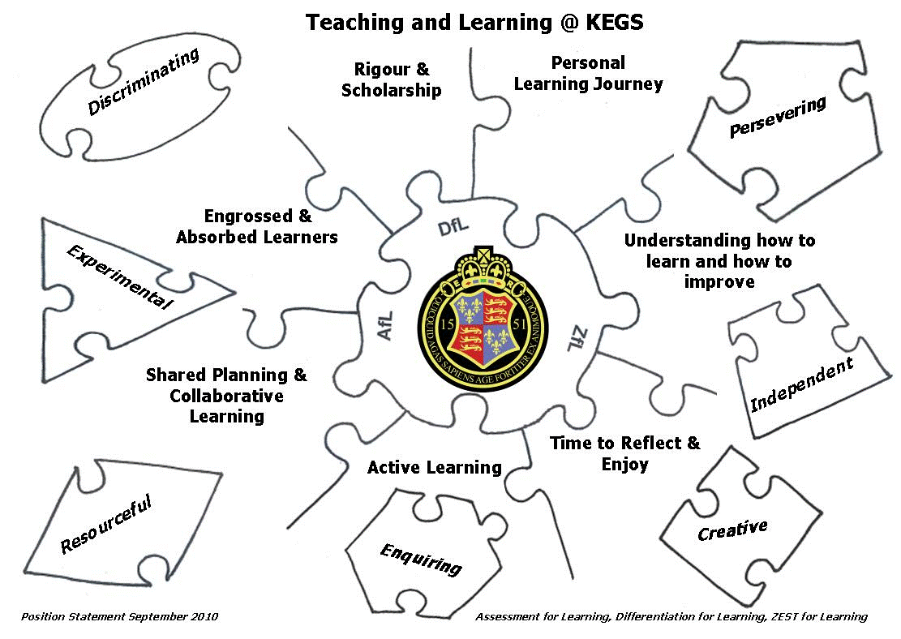

Slide 3
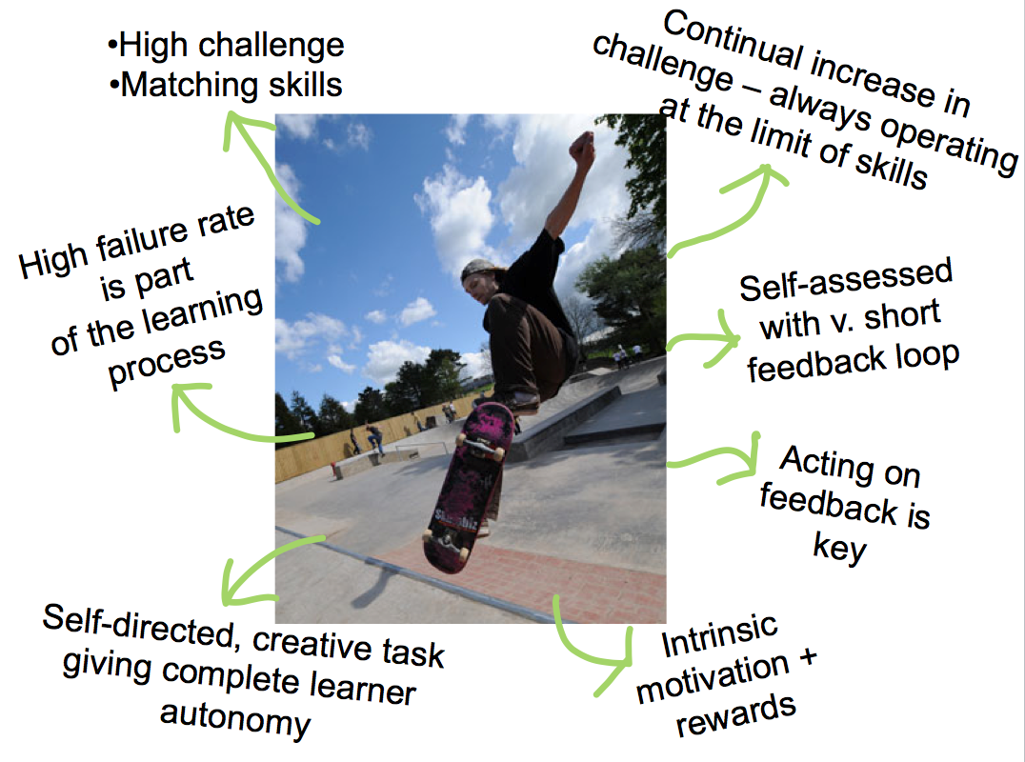

Slide 4
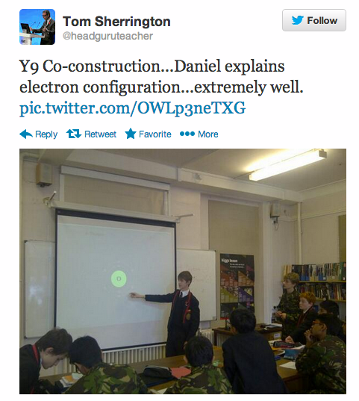

Slide 5
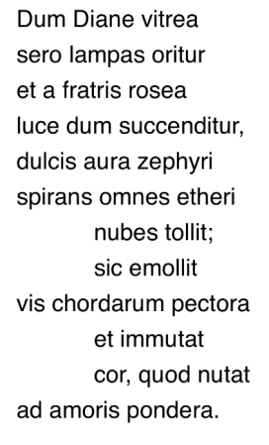
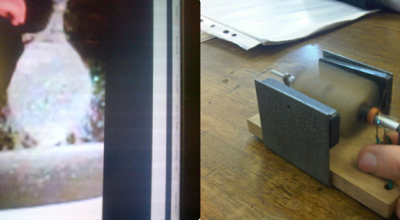
Notes:
AWE!!!

Slide 6
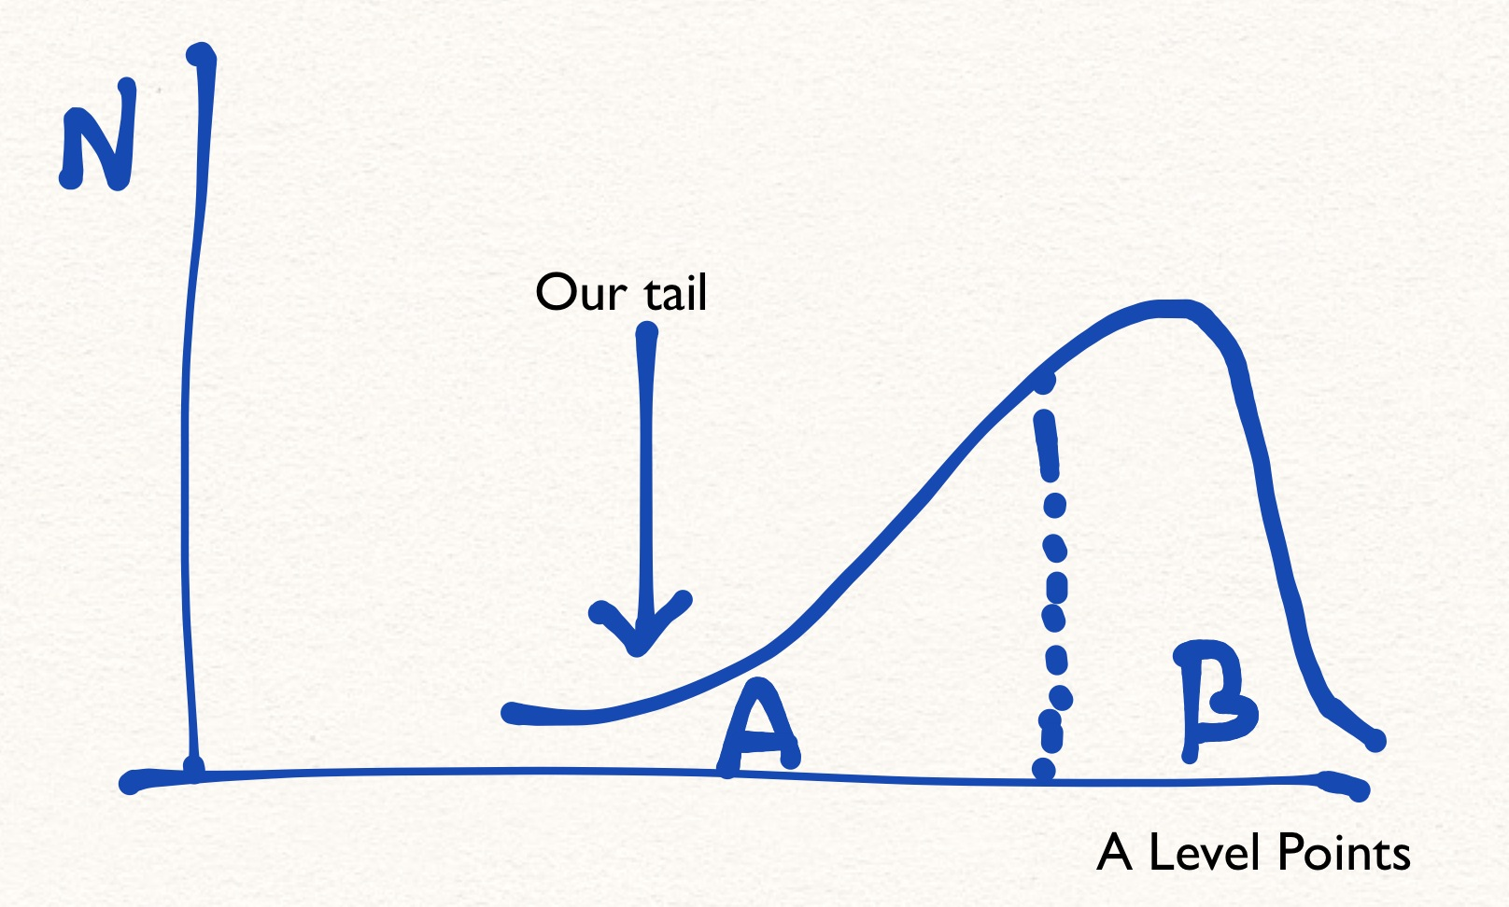

Slide 7

Learning

Slide 8
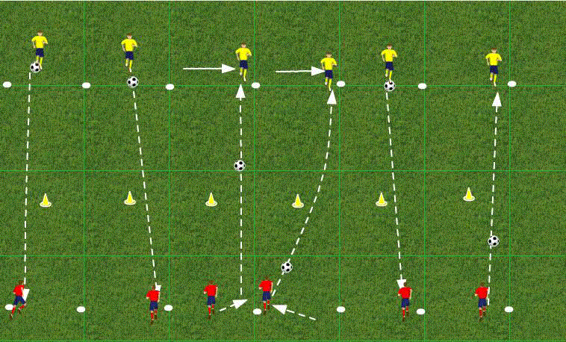

Slide 9
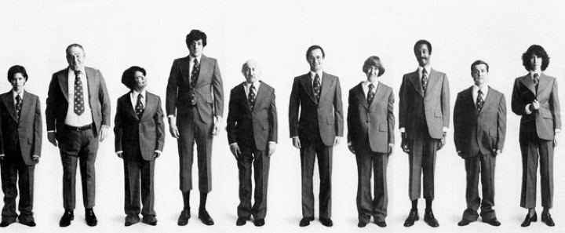

Slide 10
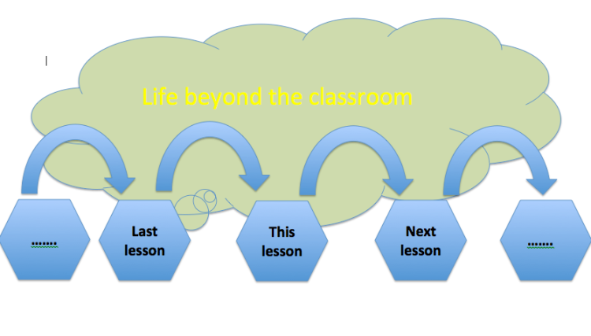
Notes:
The world students inhabit between lessons can be very different.
Sending students out of the door at the end of the lesson with assumptions of uniformity; with uniform expectations. But we need to understand different students’ contexts..

Slide 11
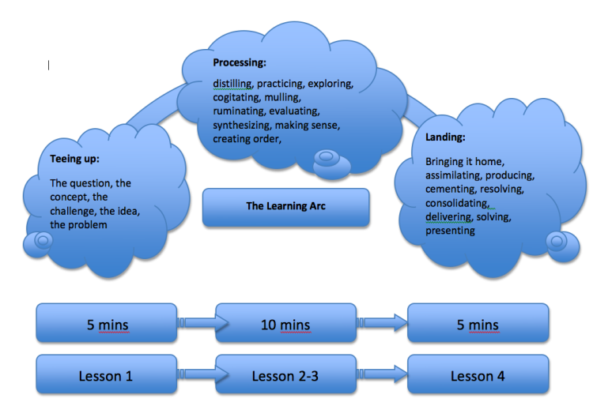
Notes:
Students start at different points
They process in different ways
Students land at different points and in different ways. ..

Slide 12
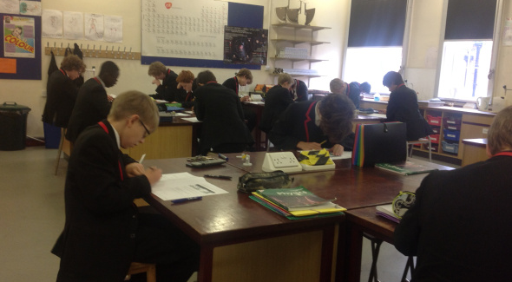

Slide 13
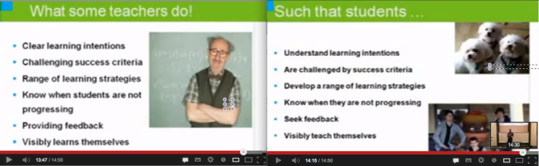

Slide 14
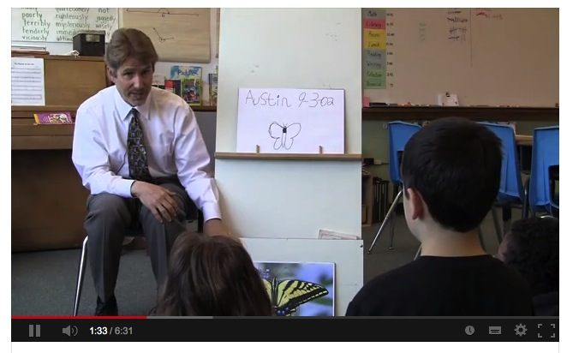

Slide 15
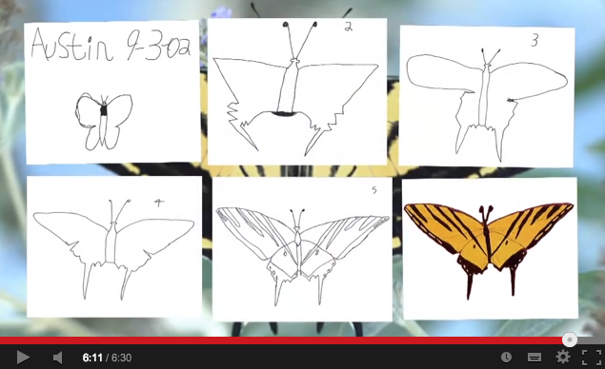

Slide 16
Ron Berger: ‘An ethic of excellence’
Once a student sees that he or she is capable of excellence, that student is never quite the same. There is a new self image, a new notion of possibility. There is an appetite for excellence. After students have had a taste of excellence, they’re never quite satisfied with less; they’re always hungry.’
It is clear that quality work I show audiences is not the result of gifted students nor specially selected students: It is a celebration of hard work, dedication, support, critique, and revision. It is the fruit of sweat and care. It showcases more than anything a school ethic and culture that compels students to achieve more than they think possible.
Students may have different potentials, but, in general, the attitudes and achievements of the students are shaped by the culture around them: Students adjust their attitudes and efforts in order to fit into the culture.

Slide 17
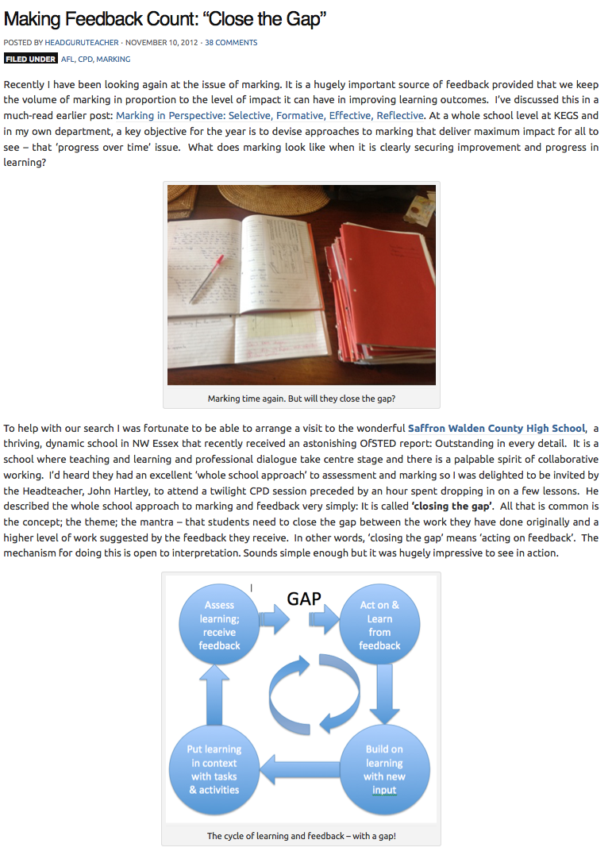

Slide 18
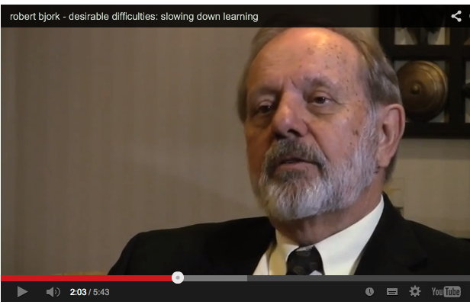
Notes:
Learning vs Performance…..slow learning

Slide 19
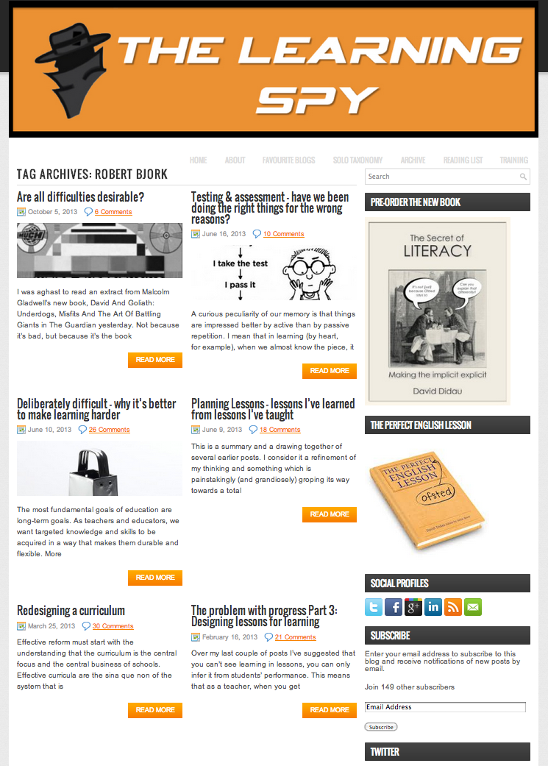
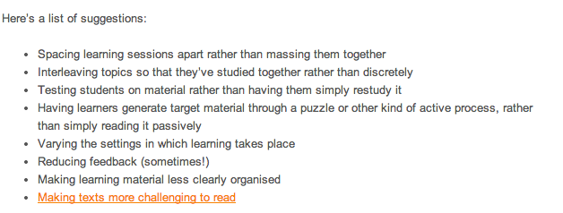

Slide 20
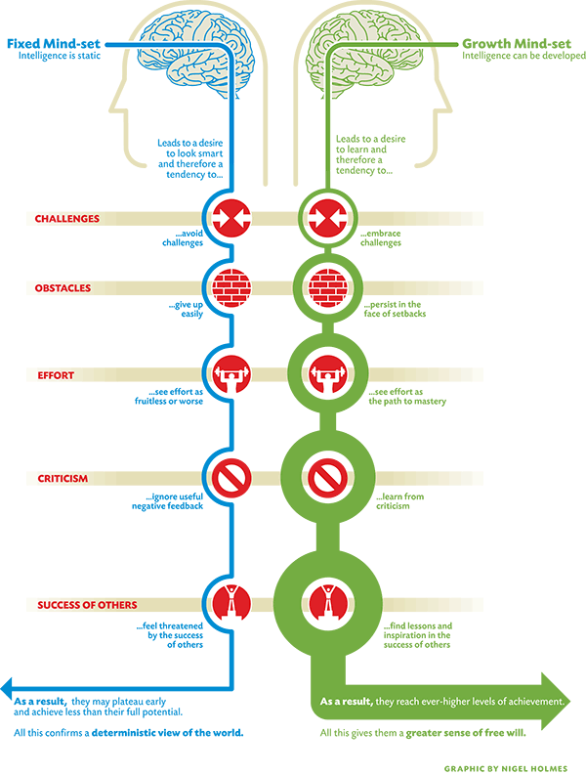
Notes:
High Starters. Not GnT
I can’t do it…. YET
Reward effort ; don’t label.

Slide 21
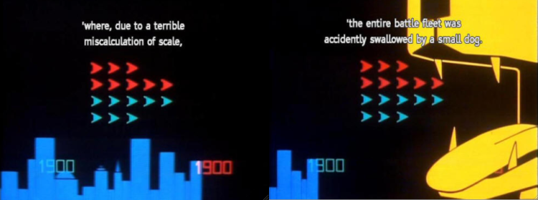
After millennia of battle the surviving G’Gugvuntt and Vl’hurg realised what had actually happened, and joined forces to attack the Milky Way in retaliation. They crossed vast reaches of space in a journey lasting thousands of years before reaching their target where they attacked the first planet they encountered, Earth.
Due to a terrible miscalculation of scale the entire battle fleet was swallowed by a small dog.

Slide 22
The most important thing…
Not data
Not OfSTED
Not technology
Not the latest initiative
Not what’s on the syllabus
It’s Pedagogy: This trumps everything.
We can all be better teachers- but this requires deliberate practice

Slide 23
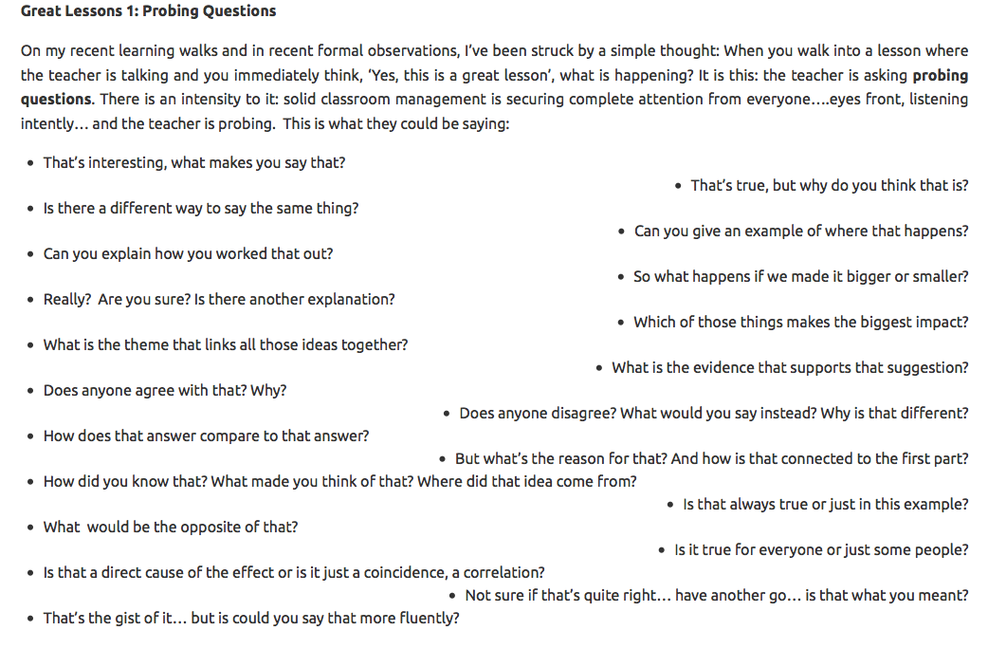

Slide 24
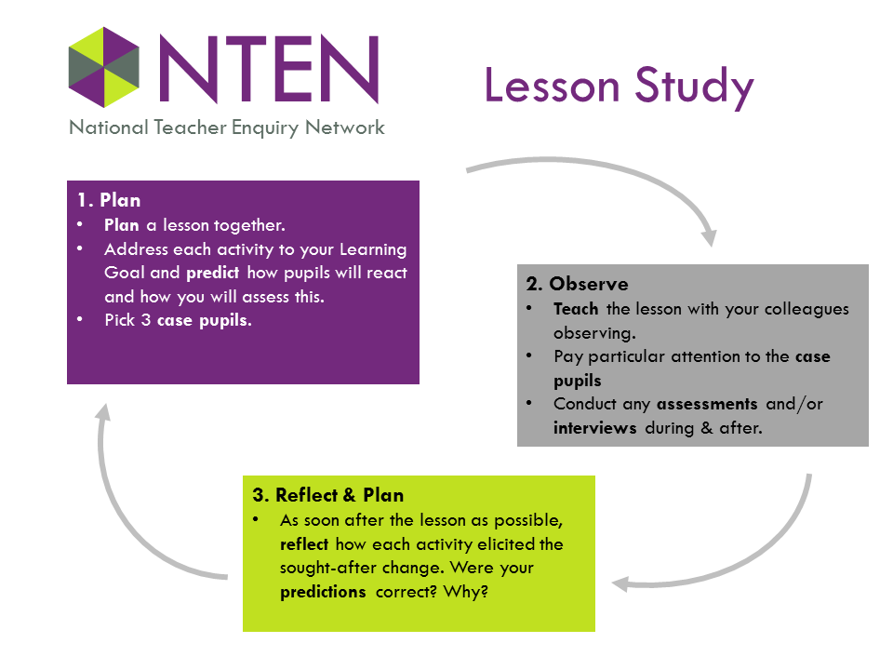

Slide 25
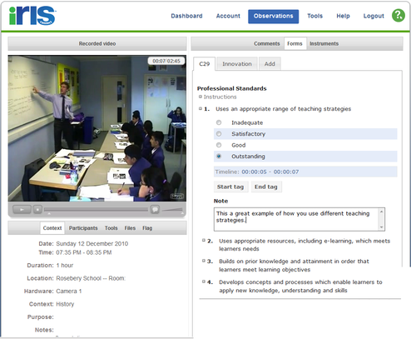

Slide 26
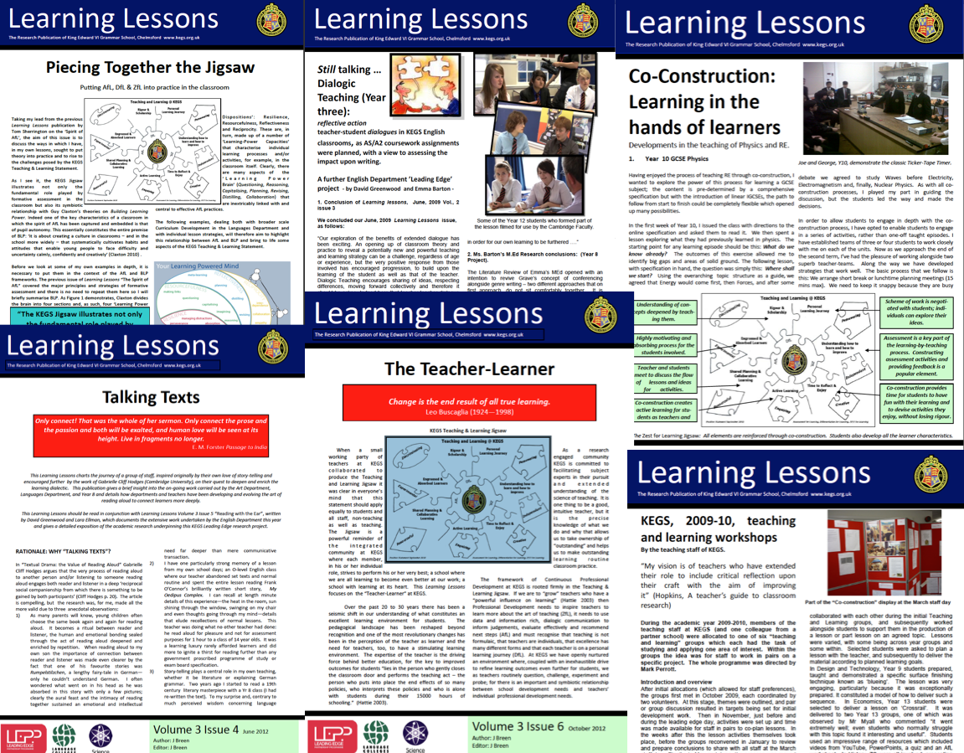

Slide 27
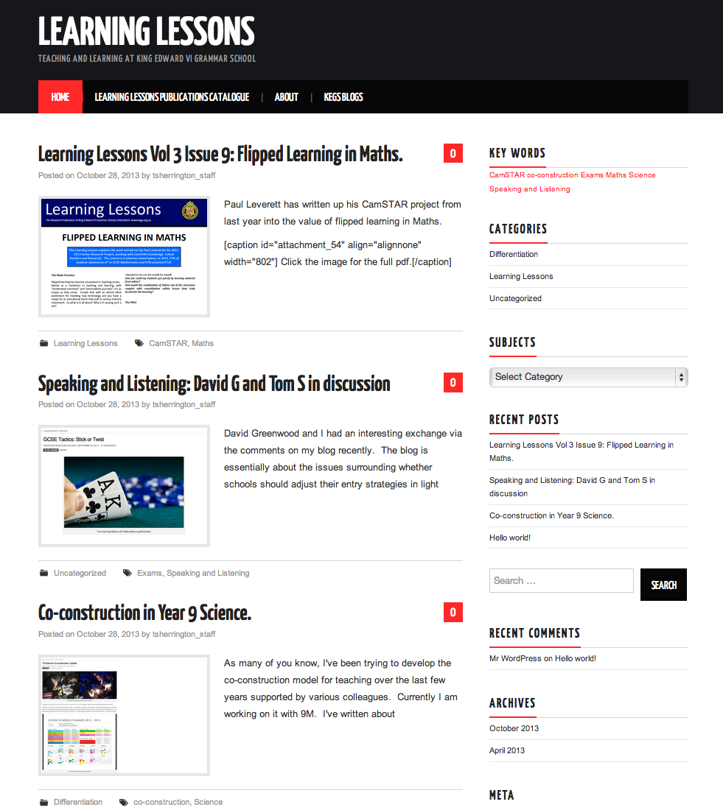

Slide 28





Slide 29
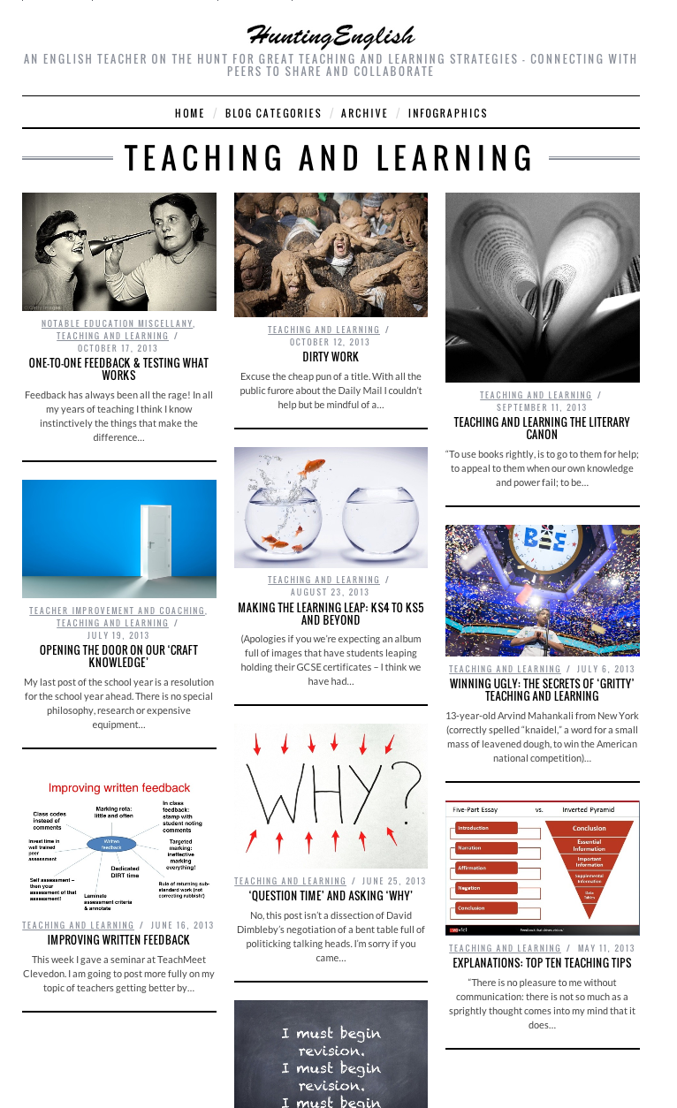
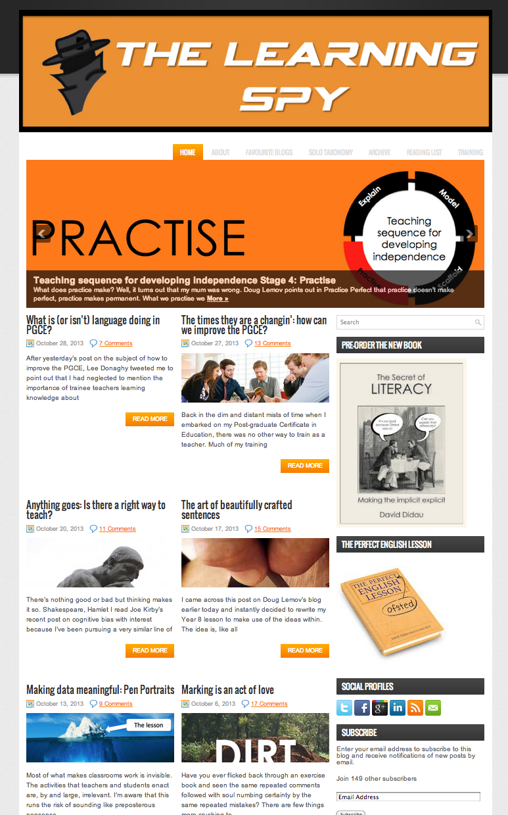

Slide 30
Being Research Engaged:
Reading Research
Continually Evaluating Practice
Engaging in Action Research
  Key Question
  Evidence Collection
  Evaluation: qualitative; quantitative
  Conclusions
  Dissemination

