Slide 1

Redesigning Schooling: a grassroots movement
ResearchEd, Dulwich College
Tom Sherrington, Chair of Vision 2040
Tom Middlehurst, Head of Research

Slide 2

What is Redesigning Schooling and Vision 2040?
The campaign
March symposia
Vision 2040
Pamphlets
  Williamson, Why the need for change
  Claxton and Lucas, What kind of teaching for what kind of learning
  Wiliam, Principled curriculum design
  Matthews, Intelligent accountability
  Middlehurst, Student Impact
  Chambers, Employers
  Lucas, Parents
  Wiliam, Assessment
  Fullan and Hargreaves, Professional capital for the UK
National Conference 2013
5 – 6 December, Manchester Central

Slide 3
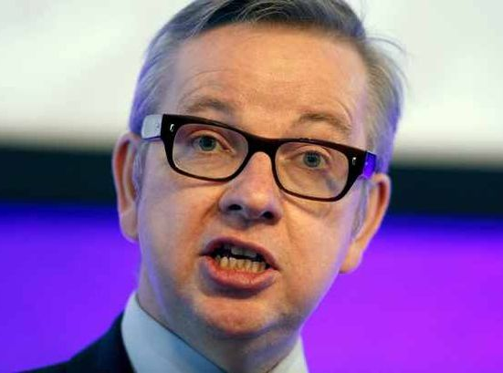
Why now?
“. . . professional development for teachers is a central priority for the Department.
We are actively considering how we can encourage all teachers to take part in more professional learning.
We are particularly keen to help teachers to make better use of educational research.”
The Rt Hon Michael Gove MP
Letter to the Teacher Development Trust
2013

Slide 4
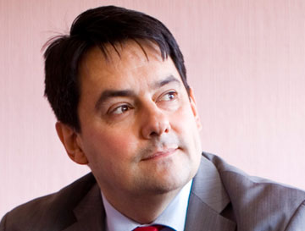
Why now?
First, we need greater emphasis on the importance of CPD for teachers. This agenda needs to be delivered through collaboration between schools.
Second, we need to make it the norm . . . that they use data to systematically evaluate the impact of development strategies for effective teaching and learning.
Stephen Twigg MP
Teaching Leaders Quarterly
2013

Slide 5
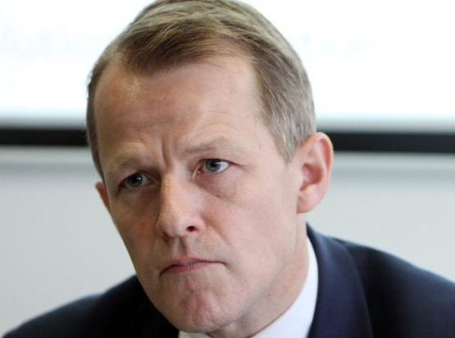
Why now?
“To improve training and professional development of teachers, leaders and support staff, we will . . . help talented teachers develop into school leaders, and introduce new ways for teachers to improve their teaching based on evidence about what works”
The Rt Hon David Laws MP
Department for Education
2013

Slide 6

The evidence
Countries that have succeeded in making teaching an attractive profession have often done so not just through pay, but by raising the status of teaching, offering real career prospects, and giving teachers responsibility as professionals and leaders of reform.
This requires teacher education that helps teachers to become innovators and researchers in education, not just civil
servants who deliver curricula.
PISA 2012

Slide 7


Slide 8
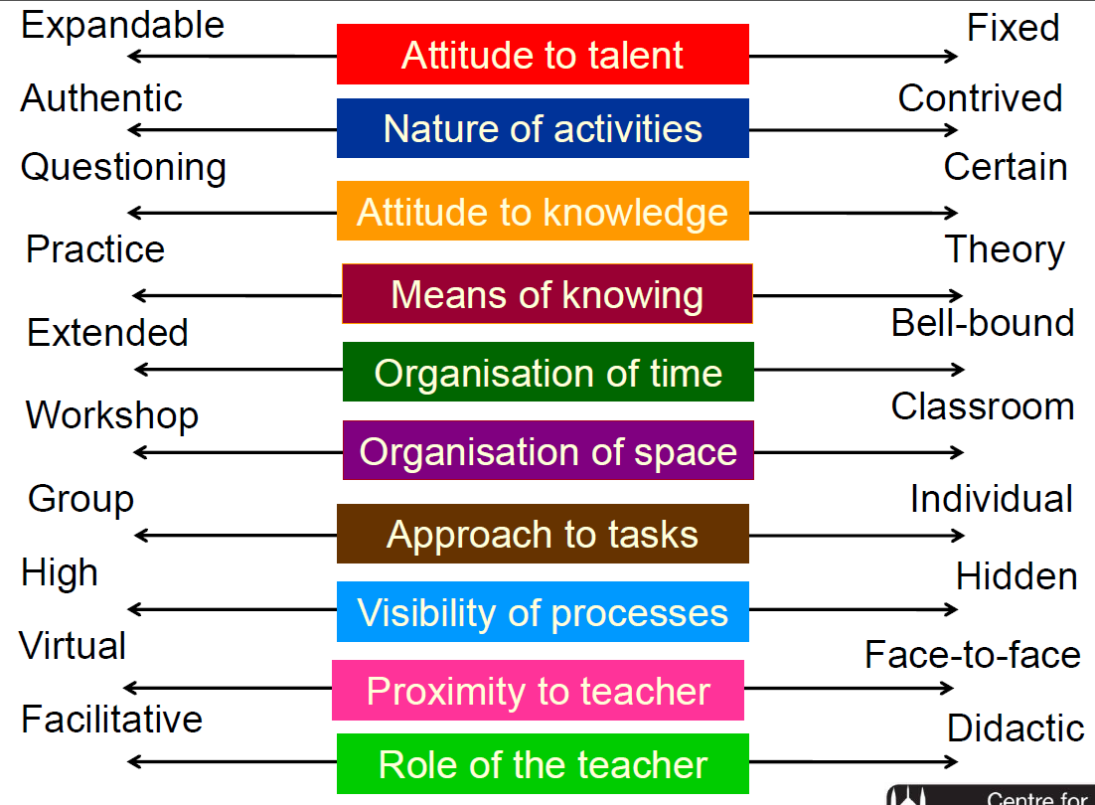

Effective teaching and learning
Claxton & Lucas

Slide 9
T&L Research Projects
What are the characteristics of effective learners and the contexts in which they develop in your own schools?
Bite-sized case studies.
Define the characteristics of effective learners at the different stages of their school career from EY to 18 (scope to unpack the context beyond age / stage …)
‘Test’ the characteristics against a broad range of different schools and contexts
Exemplify the definition using this broad range of schools
Develop a film of ‘characteristics of effective learners’
Models of learning to re-educate and engage parents
Identify practice with impact in our own and other schools
Summarise research to date link school based evidence to the research
Work with a range of schools in collecting ‘parent voice’ – what have parents found most effective in engaging with their child’s learning, breaking down barrier to being involved at school?

Slide 10
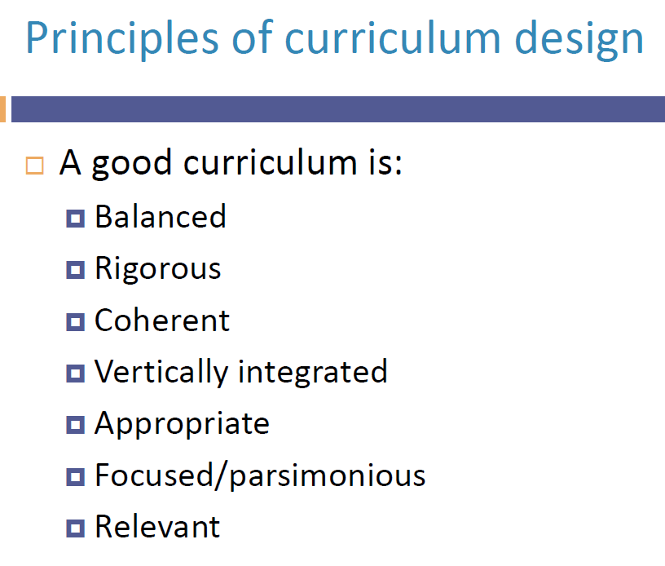
Principled curriculum design
Wiliam

Slide 11
Curriculum Research Projects
The extent to which school curriculums are designed based on principles, student experiences, or policy
What is happening in schools to develop the wider curriculum
Comments about the nature of these changes being ‘principled curriculum design’ and /or principled Cd in response to principles or policy and clarity about validation of wider skills and experiences with/for students in our own schools
Principled curriculum design in practice – exemplifying how some schools are responding to the validation of wider skill and experience with alternatives
Balancing the wider school curriculum with the national curriculum
How we balance the compulsory curriculum within a wider, coherent school curriculum.
How we defining success for individual schools and students
How our Catholic ethos is the foundation to go beyond a narrow definition of success, happiness and fulfilment & emphasising the development of the whole person.

Slide 12
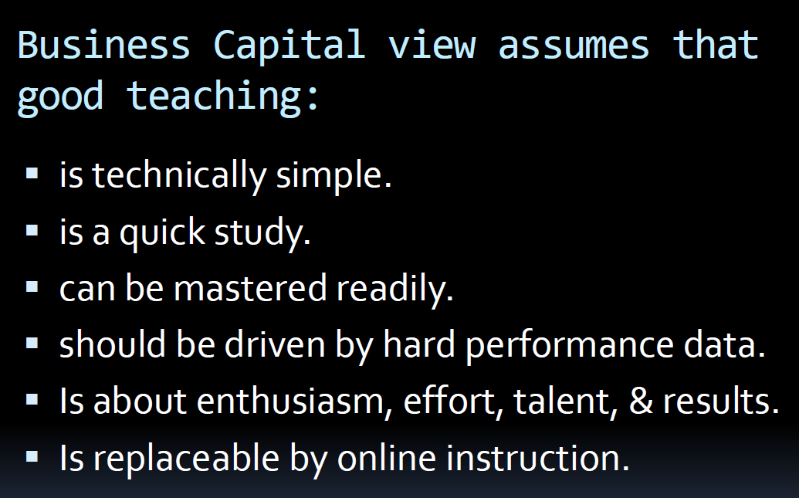
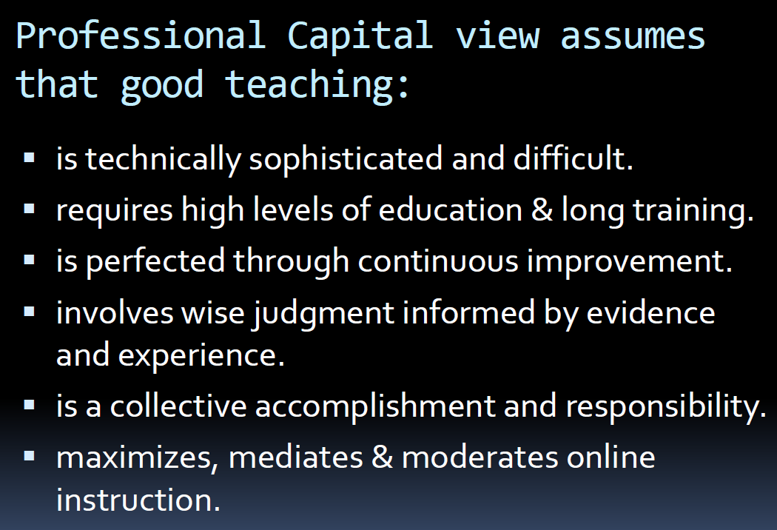
Professional capital
Hargreaves

Slide 13
Professional Capital Research Projects
The relationship between effective pedagogy, leadership and CPD on professional capital
Genuine CPD; developmental models - 'teacher never finished‘
The connection between effective leadership & the core purpose of teaching & learning in our schools
draw conclusion and evidence an assertion/critique: Professional capital can be achieved through connecting effective leadership & the core purpose of teaching & learning
Models of effective leadership and CPD and the evidence-based movement in education
The role of leadership in developing professional capital.
Models of excellent CPD/ ITT partnerships/ leadership practices that fuel strong CPD.
Explore practice across other schools to gather evidence:
Professional capital and confidence – the need to be evidence based

Slide 14
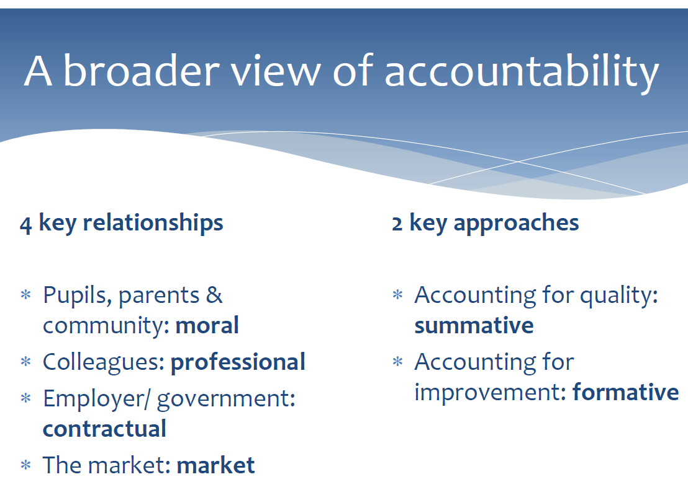
Intelligent accountability
Gilbert

Slide 15
Intelligent accountability Research Projects
Self confident schools
Studies of self confident schools – a range of good and outstanding schools who display confidence
How did you Ofsted prep / self evaluation (ie contractual accountability) lead to improvement
The professions view: does accountability lead to improvement
Alternative models ie: peer accountability, local partnership, governance
How does accountability secure improvement? What else matters?
Alternatives to Ofsted
The cost of school-based inspections to the country
The relationship between pre-inspection data and ultimate outcome
The price of an alternative model (i.e. local partnership)
Recommendations for moving forward

Slide 16


