Slide 1



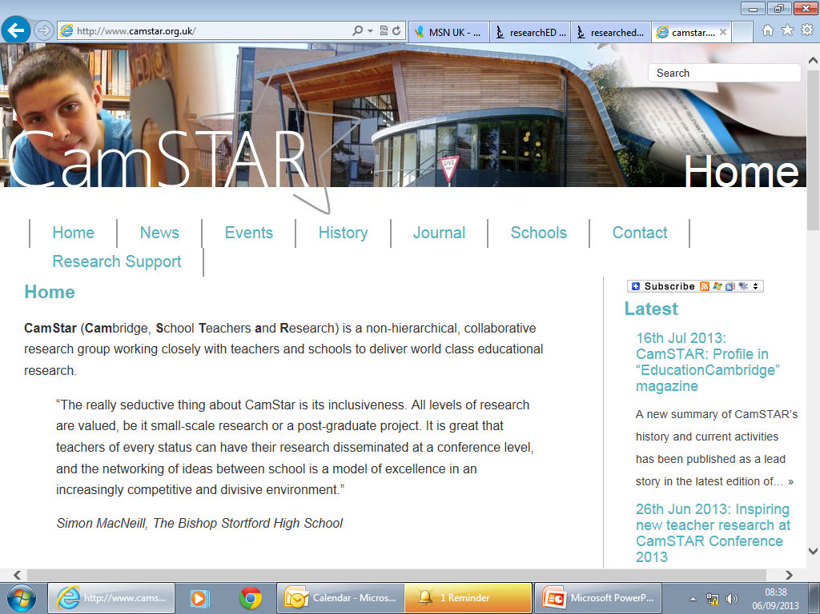
Action Research and CamSTAR
What can we learn?
Tom Sherrington @headguruteacher

Slide 2
The KEGS context
A ‘research-engaged learning community’
Research as CPD: CPD as Research

Slide 3
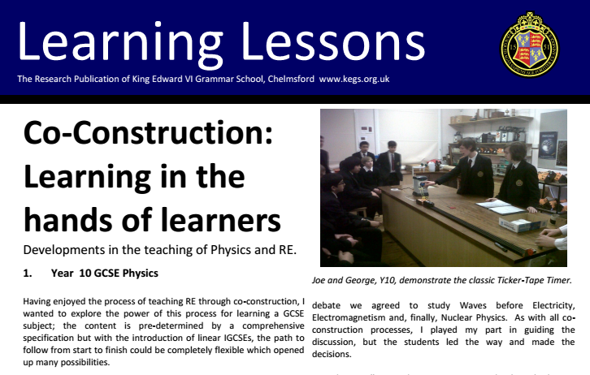
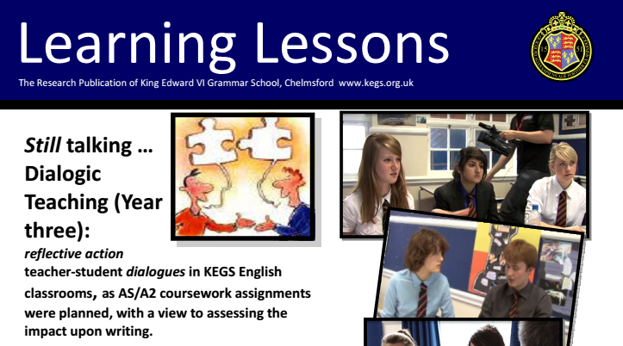
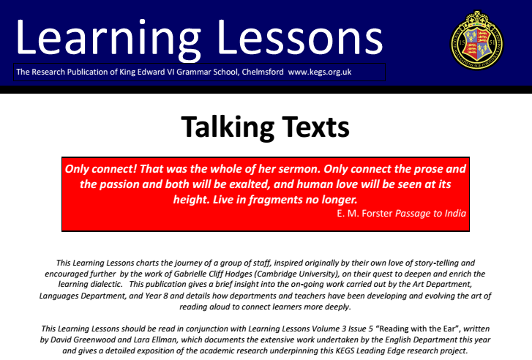
Learning Lessons

Slide 4
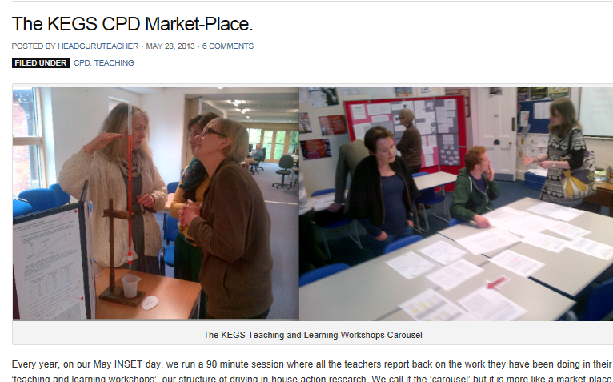
Teaching and Learning Workshops:
Market-place CPD

Slide 5
Example explorations
Philosophy and RE Essays
Economics Journal and blogsite
Physics marking
Explorations into coaching
Differentiation in PE lessons
Exploring portraits in Year 7 Art.
An evaluation of our KS4 ‘intensive care’ Mentoring scheme
Evaluation of ‘How Science Works’ questions within iGCSE Chemistry
KS3 Reading Aloud project from English
English A2/Pre-U ‘gallery critique’
Use of ipads and Tumblr in PE GCSE and A level
Developing use of podcasts and social learning platforms in History

Slide 6
Is it research?
Validity?
Transferability?
Impact?

Slide 7
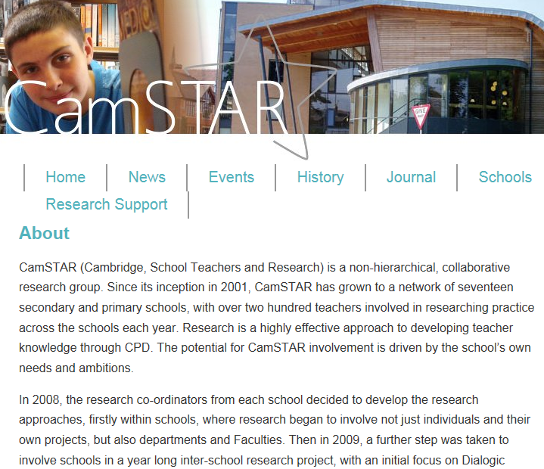

Slide 8
CamSTAR: Cambridge Schools Teachers & Research
At KEGS, 16 teachers in 11 different groupings engaged in CamSTAR projects last year
formulating a question to explore,
developing an effective methodology,
conducting an impact analysis
reporting findings for a peer audience.

Slide 9
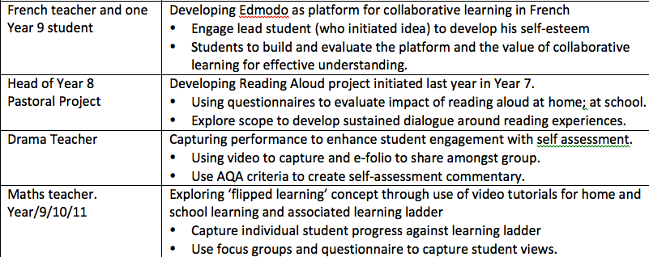
CamSTAR Projects:

Slide 10
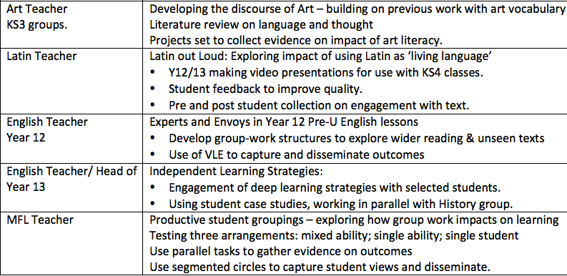
CamSTAR Projects:

Slide 11
Research Methods
Assessment Data: Pre and post-test. Fair test?
Questionnaires: question design?
Qualitative observation,evaluation. Rigour?
Student interviews: Personal responses? Sample size?
Teacher interviews: confirmation bias?

Slide 12
Example: Co-construction

Slide 13
Value of Action Research?
Culture of self-evaluation and questioning
A sense in which the process matters as much as the outcome
Value judgements for a process based on values?
Value as true within context vs general ‘truth’
It works for me. Is that good enough?

