Slide 1






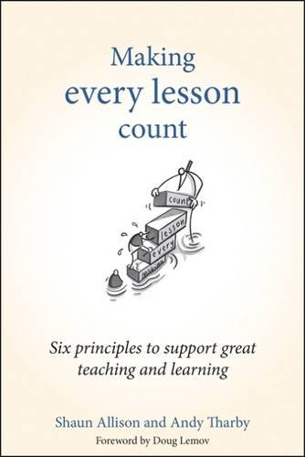
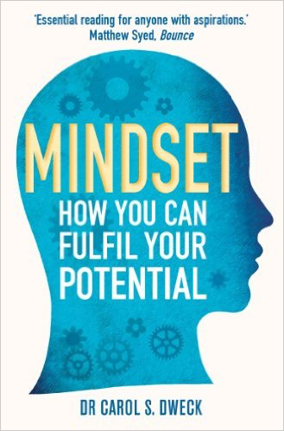

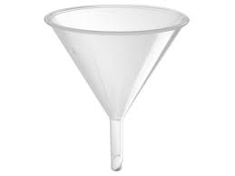


Homework.
To Set or Not to Set?
A case study in reading research
Tom Sherrington
#TDC2018
@teacherhead
teacherhead.com
Consultancy : CPD : Speaker

Slide 2


Slide 3
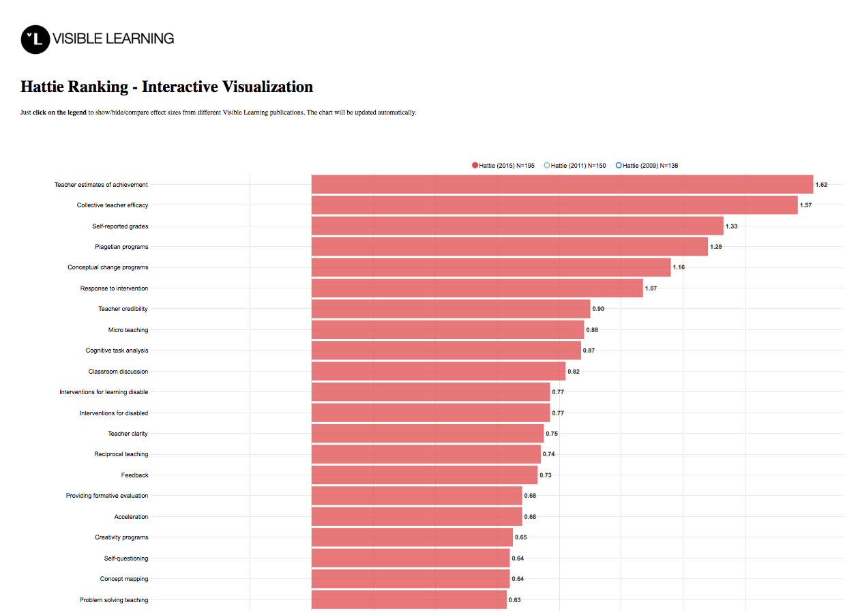
Teacher Estimates of achievement 1.62
Teacher Credibility 0.90
Cognitive Task Analysis 0.87
Reciprocal teaching 0.74
Feedback 0.73

Slide 4
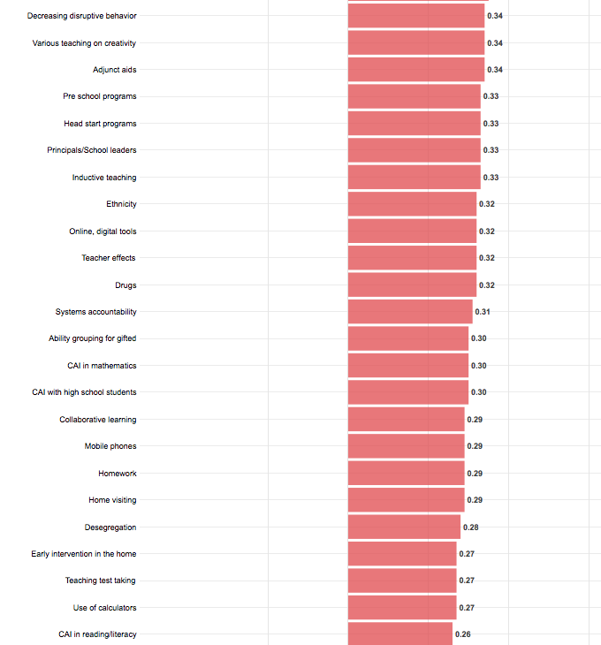
Drugs 0.32
Homework 0.29
d = 0.29

Slide 5
Technical details:
Five meta-analyses that capture 161 separate studies involving over 100,000 students
Effect size d= 0.29 suggests homework is improving the rate of learning by 15% – or advancing learning by about a year
65% of effects were positive; 35% of effects were negative
Average achievement exceeded 62% of the levels of students not given homework..
d= 0.29 effect translates into a 21% chance that homework will make a positive difference. Or, from two classes, 21 times out of a 100, using homework will be more effective.

Slide 6
How good is the effect?
Hattie cites Cohen as suggesting
0.2 is small,
0.4 is medium and
0.6 is large
We need a hinge-point where d > 0.4 is needed for an effect to be above average and d > 0.6 to be considered excellent.

Slide 7
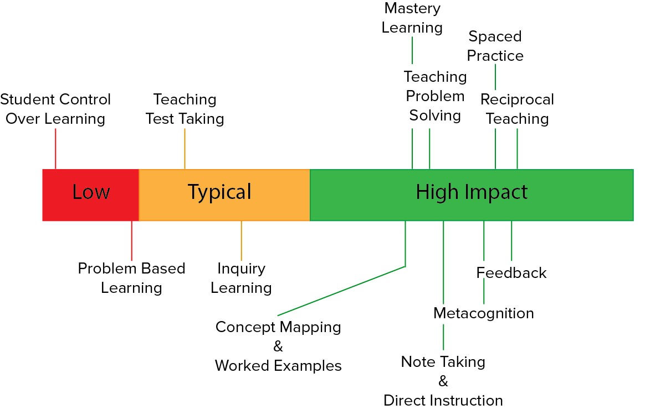
Range of effects:

Slide 8
But look at the detail:
For primary: d = 0.15
BUT…….
For secondary d = 0.64
So for primary, effect size is small.
For secondary, effect size is excellent?!

Slide 9
Effect size rankings are problematic
It depends on:
The precision of the task – eg addition, phonics, recall test
The age and nature of the students
The nature of the measure of attainment
The nature of the homework task
The level of supervision required
….. And all the studies show significant variation between them.

Slide 10
What Hattie actually says about homework is complex.
There is no meaningful sense in which it could be stated
“the research says X about homework” in a simple soundbite.
There are some lessons to learn:
The more specific and precise the task is, the more likely it is to make an impact for all learners. Homework that is more open, more complex is more appropriate for able and older students.
Teacher monitoring and involvement is key – so putting students in a position where their learning is too complex, extended or unstructured to be done unsupervised is not healthy. This is more likely for young children, hence the very low effect size for primary age students.

Slide 11
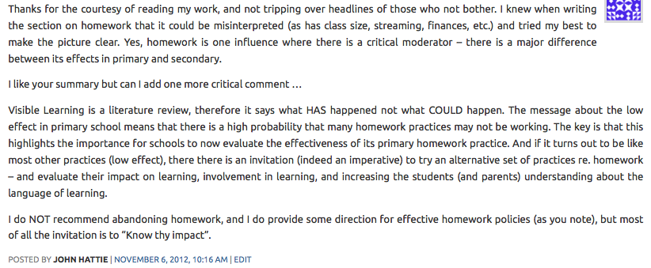
Hattie’s comment……

Slide 12
Hattie’s comment:
Thanks for the courtesy of reading my work, and not tripping over headlines of those who not bother. I knew when writing the section on homework that it could be misinterpreted (as has class size, streaming, finances, etc.) and tried my best to make the picture clear. Yes, homework is one influence where there is a critical moderator – there is a major difference between its effects in primary and secondary.
I like your summary but can I add one more critical comment …Visible Learning is a literature review, therefore it says what HAS happened not what COULD happen.
The message about the low effect in primary school means that there is a high probability that many homework practices may not be working.

Slide 13
Hattie’s comment 2
The key is that this highlights the importance for schools to now evaluate the effectiveness of its primary homework practice. And if it turns out to be like most other practices (low effect), there there is an invitation (indeed an imperative) to try an alternative set of practices re. homework – and evaluate their impact on learning, involvement in learning, and increasing the students (and parents) understanding about the language of learning.
I do NOT recommend abandoning homework, and I do provide some direction for effective homework policies (as you note), but most of all the invitation is to “Know thy impact”.

Slide 14
Center for Public Education 2007
The link between homework and student achievement is far from clear. There is no conclusive evidence that homework increases student achievement across the board. Some studies show positive effects of homework under certain conditions and for certain students, some show no effects, and some suggest negative effects
(Kohn 2006; Trautwein and Koller 2003).

Slide 15
Center for Public Education 2007
Homework appears to have more positive effects for certain groups of students:
  Older students benefit more from homework than younger students.
  Students from low-income homes may not benefit as much from homework as those from higher-income homes.
  Students with learning disabilities benefit from homework under certain conditions.
  Homework may have nonacademic benefits. Certain nonacademic benefits of homework have been shown, especially for younger students.

Slide 16
Center for Public Education 2007
Too much homework may diminish its effectiveness. While research on the optimum amount of time students should spend on homework is limited, there are indications that for high school students, 1½ to 2½ hours per night is optimum.
The amount of homework completed by students seems to be more positively associated with student achievement than the amount of homework assigned by teachers.

Slide 17
Center for Public Education 2007
After-school programs that provide homework assistance may improve student behavior, motivation, and work habits but not necessarily academic achievement.
The effect of parent involvement in homework is unclear. Studies of parent involvement in homework have produced mixed results. Homework assignments that require interaction between students and parents result in higher levels of parent involvement and are more likely to be turned in than non-interactive assignments
There is little research on connections between specific kinds of homework and student achievement.

Slide 18
Conclusions
Research is complex!
How we measure influences our relative scales.
Measurements are retrospective – not absolute truths.
Averages are very problematic.
Specifying variables is hugely important but also challenging.
Bulk labels for learning activities – “Homework” are unhelpful in this context

Slide 19
So, what makes good homework?
Think of homework as a diet:
A mainstay of regular practice: tasks students can definitely do but just need to improve fluency with.
Some guided research tasks.
Extended writing for those who are ready.
Some open-ended product-making tasks.
Some ‘flipped learning’ tasks.
Optional extras.

Slide 20
Regular Practice.
Learning homeworks. Self-quizzing, spelling practice, repeated maths problems of the same type. Fluency and confidence.
Students must be provided with all the materials with all the information –eg a knowledge organizer, word list.
Students should be taught the techniques explicitly including how to check their answers.

Slide 21

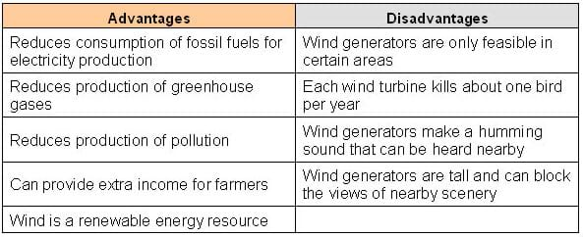

Slide 22
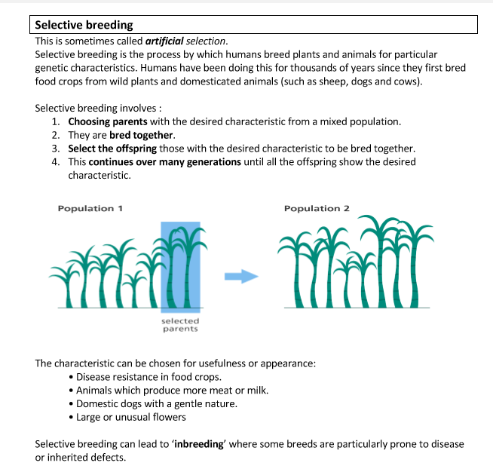

Slide 23
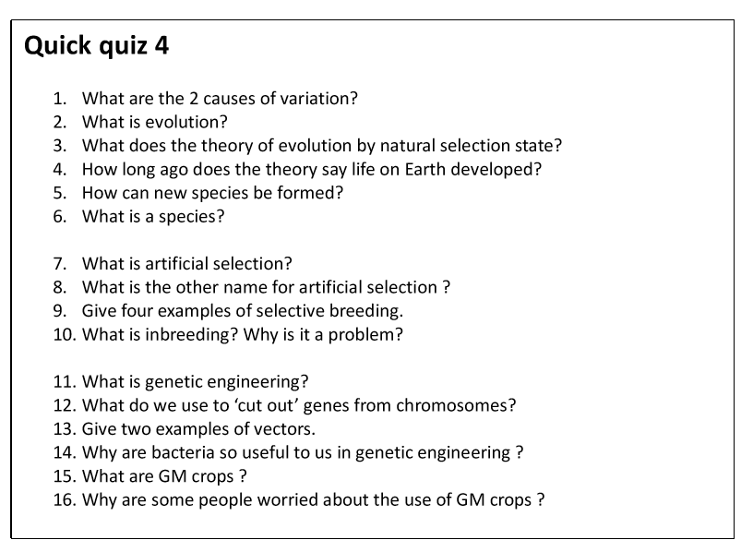

Slide 24
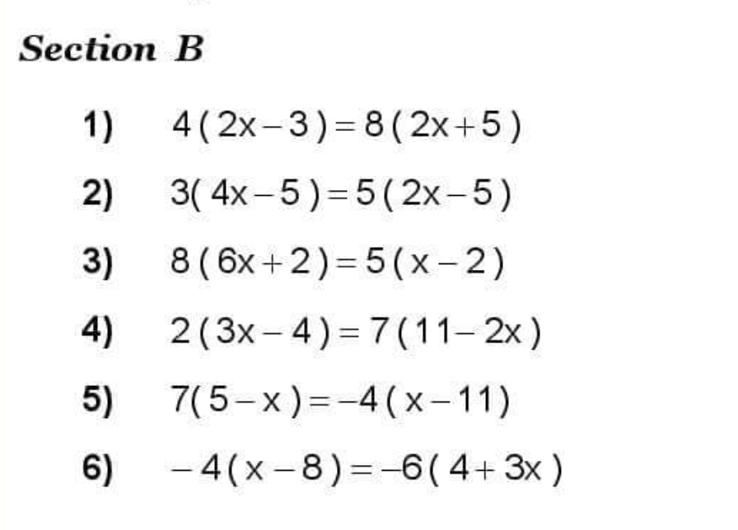
Do these questions:

Slide 25
Guided Research Tasks
Check access to resources or provide them.
Set a series of questions to find the answers to.
Avoid the open-ended ‘find out about X’ pitfall.
Provide guidance and exemplars for the format of response.
Direct less confident students to specific sources.

Slide 27

Open-ended product-making
Respond in any format: Presentation, document, video, leaflet, website
Show some exemplars to set the standard. “Dazzle me”
Guide the content requirements.

Slide 28
Extended writing – when ready

Slide 29
Some flipped learning tasks
Reading
Preparing detailed notes in advance
Trying some problems or questions in advance
Preparing a student-led teaching episode
Watching an online tutorial and responding with questions or online assessment.

Slide 30
My son’s first Y7 science homework
It began with an explanation of the ideas of Greek philosopher Democritus who
observed that water behaved in similar ways to sand – it could be stirred,
poured and mixed.
His hypothesis was that water might, therefore, be made up of small particles,
akin to grains of sand but smaller than the eye can see. He called these particles
‘atoma’.
The questions that followed were:
What is the difference between science and philosophy?
What observations did Democritus make?
What was his hypothesis?
What properties of liquids could be explained by Democritus’ hypothesis?
Does his hypothesis explain the behaviour of solids and gases?

Slide 31
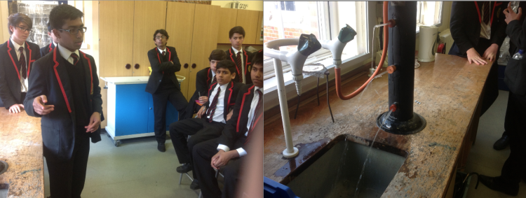
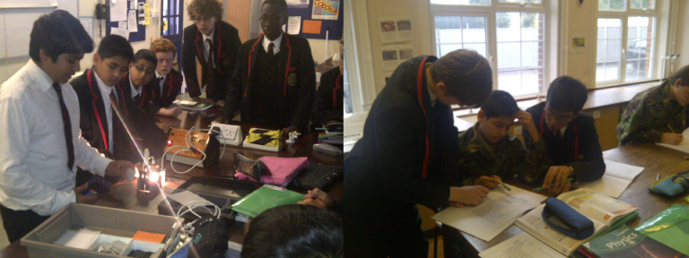

Slide 32
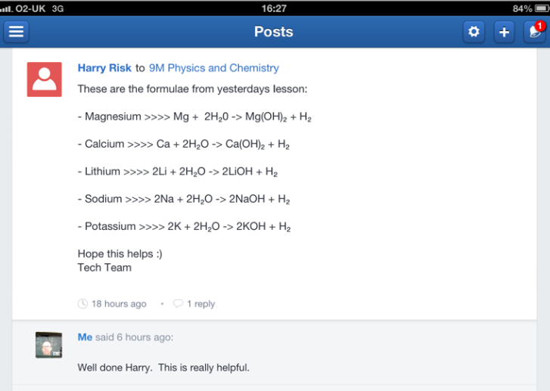
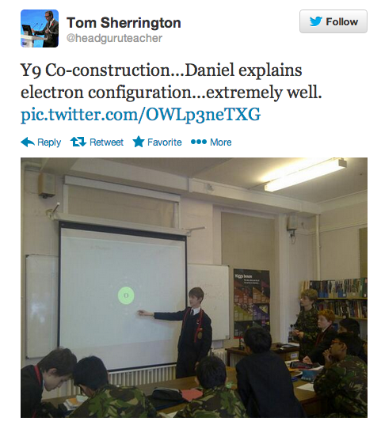

Slide 33
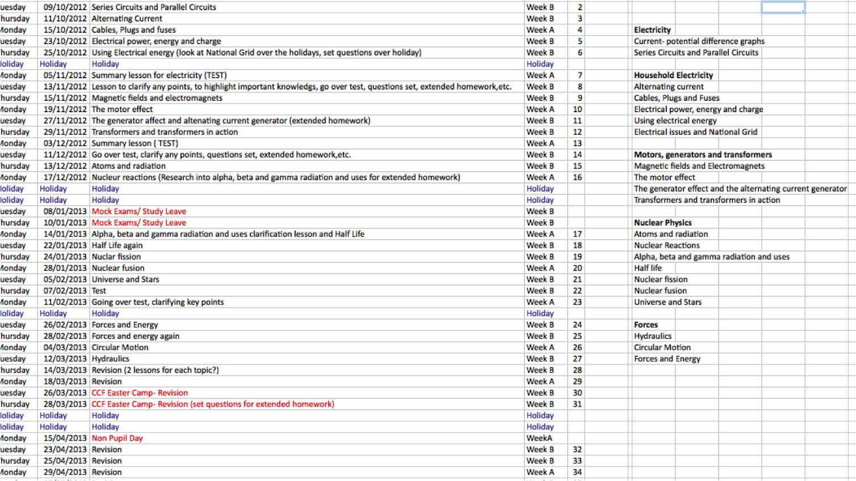

Slide 34
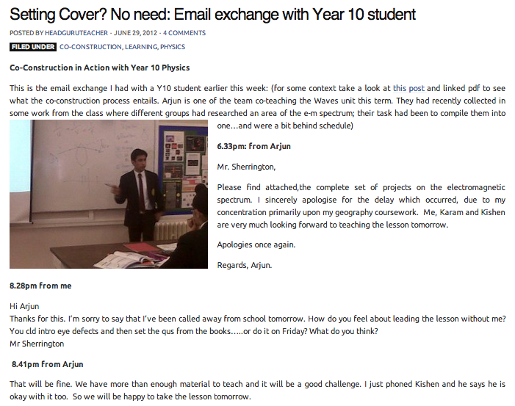

Slide 35
Thank you.
Tom Sherrington
@teacherhead
teacherhead.com
Consultancy : CPD : Speaker

Slide 36
Thoughts? Your speaker wants to hear them!
Please go to the app now and take 2 mins to tell us what you thought of this session.

